Slide 1
Advanced Telephony
February 2023

Slide 2
Redmoor Health Offer
Universal offer: access to support@redmoorhealth.co.uk Redmoor’s support centre. This provides the opportunity for brief and intensive support to overcome a challenge, ask one off questions or seek subject matter expert advice on something the practice or PCN are struggling with.
Practice offer: is around digital maturity, streamlined delivery and optimisation of system use. We will provide tactical support via webinars and workshops on how to optimise AT, managing demand and capacity, patient communication, workforce optimisation etc.
PCN offer: to streamline member practice processes into a scaled offer for their patient population. Helping to bring processes together and collaborate on scalable service delivery. For qualifying practices and PCNs we will also provide intensive, tactical, face to face support.

Slide 3
Webinars,
Helpdesk & Website
Helpdesk
support@redmoorhealth.co.uk
Quoting ref: SE AT
Webinars
Understanding Demand - Webinar Registration - 21st Feb 9am-10am
Optimising AT - Webinar Registration - 22nd Feb 12.30pm-1.30pm
Landing page
Southeast Region - Delivery for today and transformation for tomorrow webinars (redmoorhealth.co.uk)

Slide 4
Topics
Interoperability
Demand & Capacity Planning
Complaints Management
Training for Reception & Clinical Staff
Advanced Telephony

Slide 5
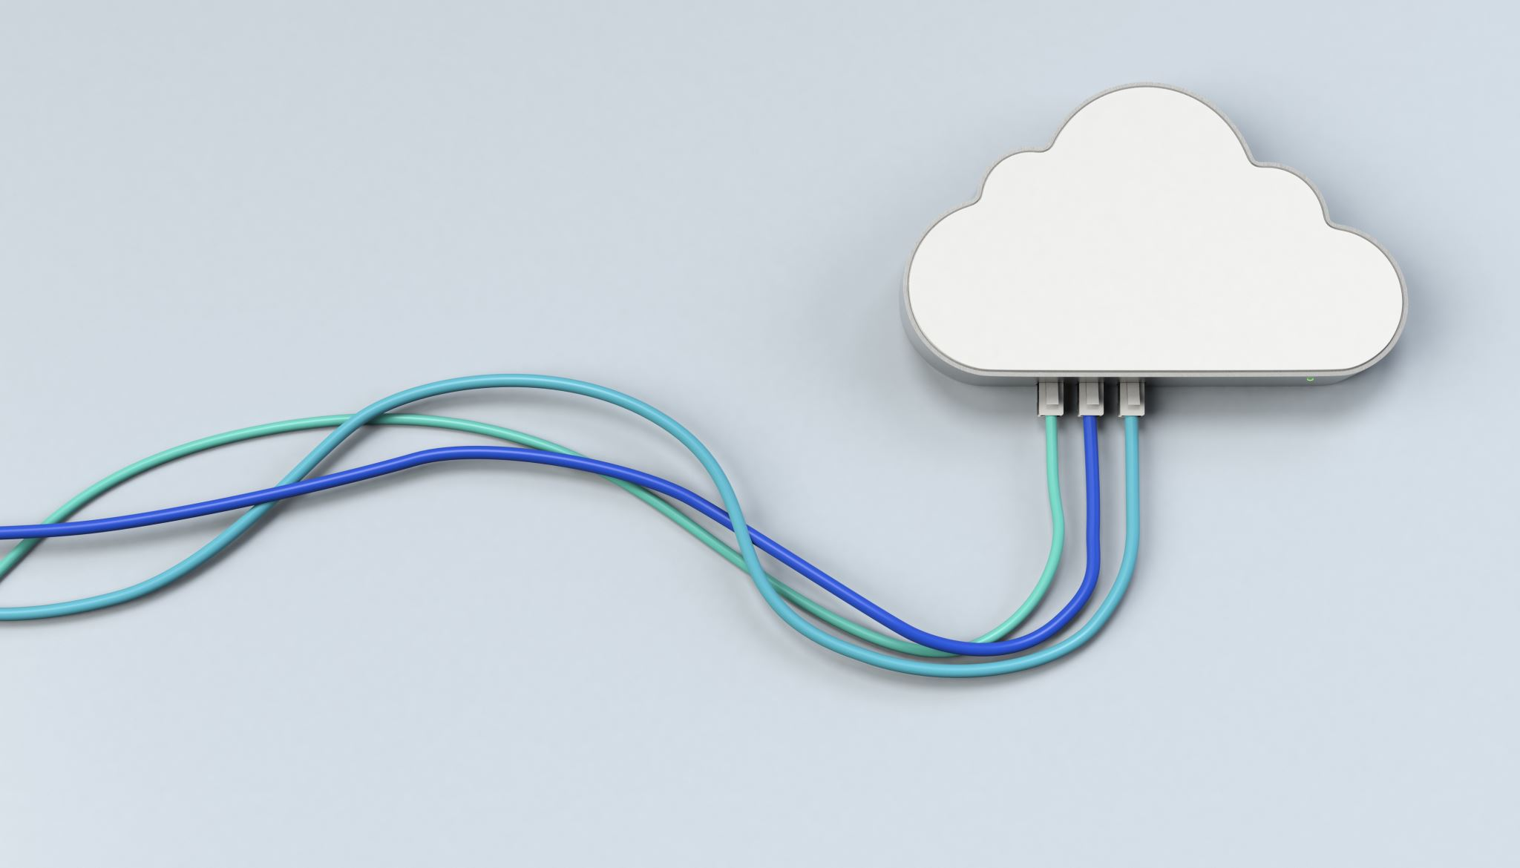
What is Advanced Telephony
Evolution not revolution
Using the advanced features of cloud telephony and telephony features that have been created specifically for Primary Care to create an efficient patient communication system.
Ensuring that systems are setup and optimised to support the practices to improve access and efficiency.
Example Features:
Clinical System Integration including data capture
Soft Phones/Mobile & PC Apps
Call Centre Technology
Patient Self Serve/Appointment Booking
Rules based re-routing, queue management
Multi Site Integration

Slide 6
Understanding
Demand

Slide 7
Demand in Primary Care
Organic Vs System Created Demand
Suboptimal telephony is a known barrier to access and service efficiency in Primary Care
Marginal Gains
1% a day improvement a day leads to 37* improvement in a year.
1% worse a day will lead to 0 in a year

Slide 8
Thinking like a call centre
”Welcome to the primary care helpdesk”
Set
Practice
KPIs
Celebrate Success
All calls to be answered within 30 seconds
Average call wait 60 seconds
Average call lengths 120 seconds
Number of abandoned calls less than 10%

Slide 9
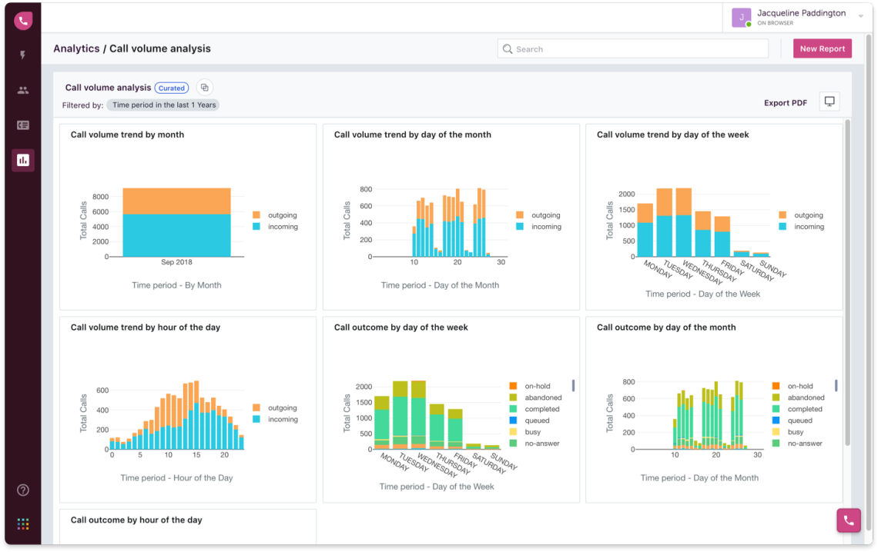
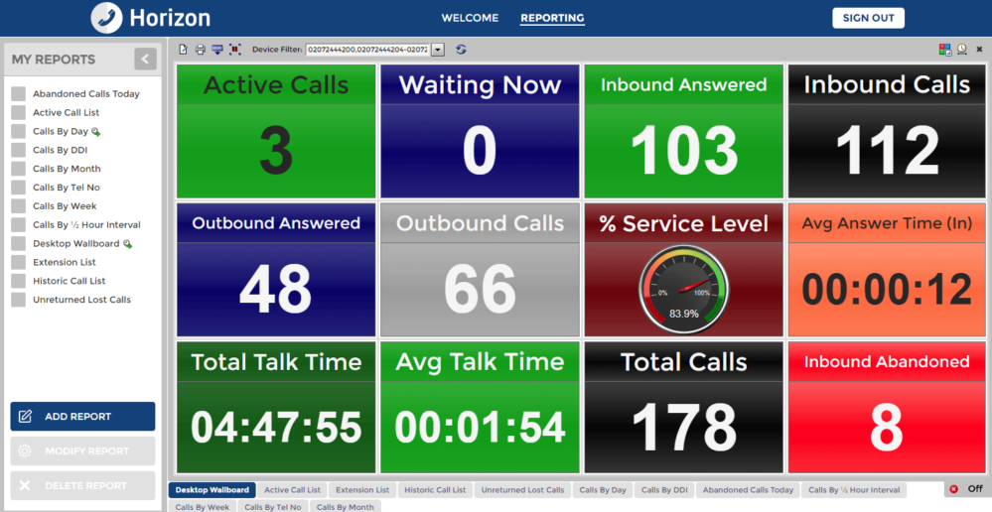
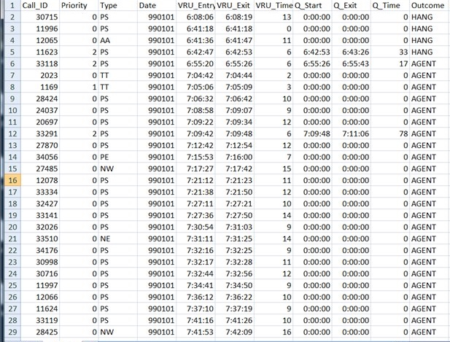
Demand Data
Telephone System – Understand Real Demand rather the perceived
Dashboard great for real time management but risk giving a false sense of demand
Raw Data allows for a greater level of understanding

Slide 10
Assessing Staff Capacity
Not all about the clinical staff
Tend to focus on clinical capacity
Look at staff capacity as a whole
Risks of rushing
How NOT to Calculate Staff Numbers!
Don’t divide the total number of call minutes by the number of hours in a day or by the number of phones available.
Use call centre techniques - Erlang Calculator
A mathematical calculation that allows you to calculate the number of staff that you need for a given number of calls, to meet a given service level.

Slide 11
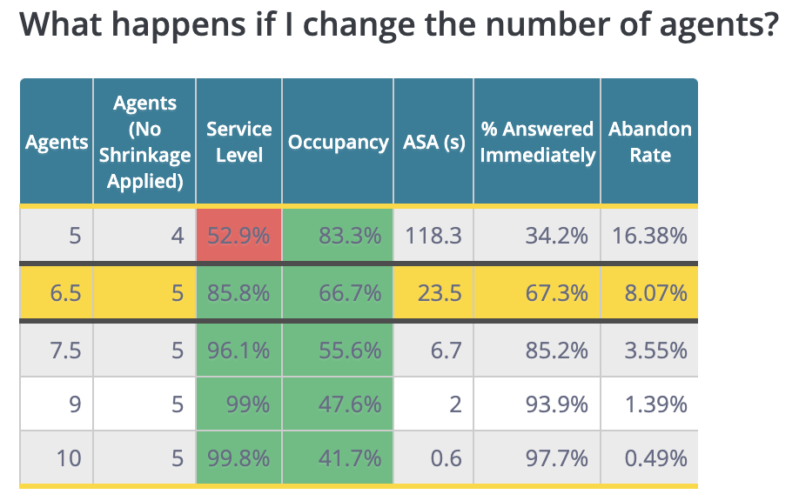
Erlang Example
8:30 – 9:30
100 calls
Answer 80% within 1 minute
20% Absence
50 Calls would still require 4 call handlers

Slide 12
Staff
Training

Slide 13
Staff Training
The phone system is the largest IT expenditure in most practices need to ensure getting return on investment!
Have a system “champion” in house
Train all staff on the basics and advanced functionality
Communication is key - Internal & External
Don’t forget physical training - Location of phone, soft phones, Headsets, Smile!
Set your KPIs - review, train, review, train

Slide 14
Complaints
Management

Slide 15
Complaints
Enable call recording
Review system to minimize causes of complaints
Use data to support complaint response
Train staff how to respond to complaints

Slide 16
Potential
Interoperability

Slide 17
Interoperability
Clinical Systems
Appointment Systems
Cross Site & Remote Working

Slide 18
Other Access Technologies
Need to ensure that optimising communication technologies so that complement each other rather than compete!
Online Consultations & Triage tools
Email
Website & Apps
SMS
Video Calling
Text and Chat Bots
Social Media
Physical Attendance

Slide 19
End
Thank you
Notes:
Stacey

