Slide 1
Regional PC and PCN Forum #2 : Digital Transformation
South East
29th November 2022

Slide 2
Agenda – 29th November 2022
Time: | Item: | Lead:
12.30 | Welcome and Introductions to the regional forum | Kamal Bahia, PCN Development Lead NHS England – SE Region
12.35 | Digital Front Door | Lisa Drake, Director of Quality, Service and Improvement Digital Programmes – Redmoor Health
12.45 | Discussion: The Role, Sharing Successes and Challenges | Geoff Berg, Deputy Director PC Workforce NHS England – SE Region
13.05 | Digital Transformation Role in Action | Andy Gove, Digital Transformation Manager, Folkstone, Hythe & Rural PCN
13.15 | Data Driven Digital Transformation - PHM | Meera Parkash, Population Health Manager Optum
13.25 | AOB, Closing word and next steps | Redmoor Health

Slide 3
Regional Primary Care & PCN Forum Launch
We were very lucky to have been able to present some of the primary care innovations at the SE Regional Winter Preparedness Event on 28/9/22. The next step was to pull together some of the other workshops that would have been presented in July and try to combine this with an opportunity to develop a regional Primary Care/PCN Forum where people can come together to hear ideas, share innovation and get information. The aim of the forum is to develop a regional community of practice and share learning.
With that in mind we have the following webinars coming up:
PC/PCN Forum
Wellbeing
Taking care of yourself and your workforce
3rd Nov
Digital Transformation
Examples of Digital Transformation
29th Nov
Leadership & Org
Development
Menu of Support
7th Dec
Leading Transition
Coping with today and planning for tomorrow
24th Jan
Primary Care in ICBs
Articulating the voice of primary care
21st Feb
These are live and can be booked using the links below. Each webinar will have an opportunity to bring everyone together along with any questions that you may need help or support with and some subject matter experts ready to help.
The aim is to have the forum rotating on a Tues/Wed/Thurs on a focussed topic, around 55 mins and starting at 12.30, free to all Practices/PCNs/Systems in the South East.
Workforce Wellbeing - Do you want to know how you can provide the maximum possible support for your workforce and for yourself?
Digital Transformation - Interested in how digital can help to transform your work? Examples of where it is working well.
Leadership & Training - Are you looking for tips on leadership training and developmental opportunities for you and your team?
Booking is very easy just visit the site here and sign up via your preferred webinar link. Any problems please contact us at england.seprimarycaretransformationteam@nhs.net

Slide 4
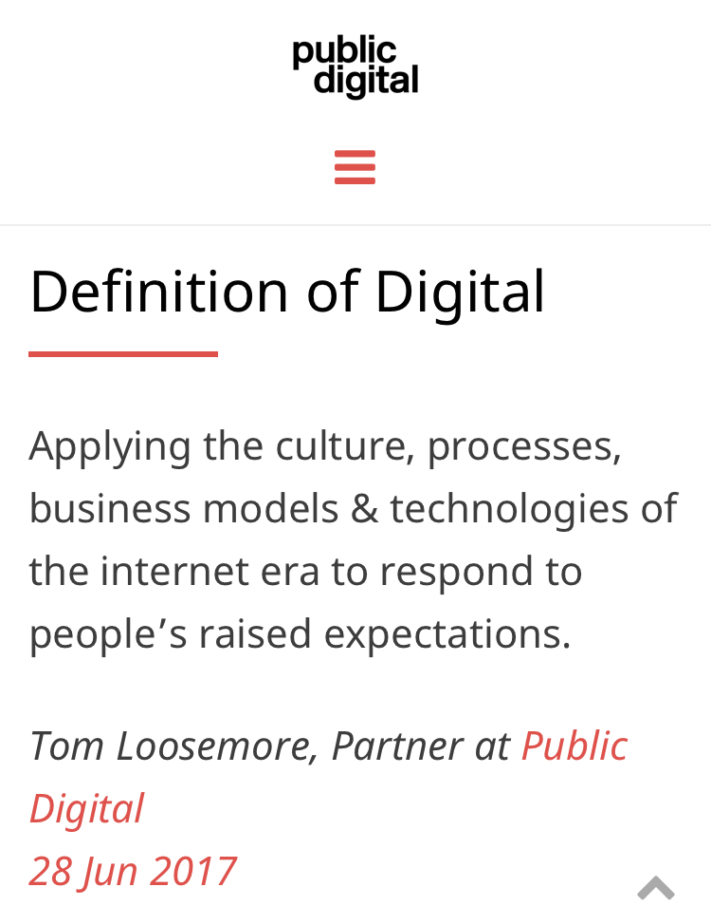

Slide 5
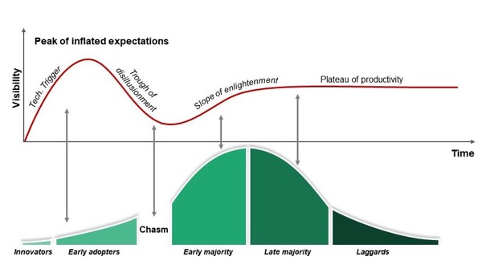
Hype cycle are you feeling deflated? Technology adoption curve where do you sit on the curve?
The “Hype Cycle” model used by Gartner since 1995 and the “Technology Adoption Lifecycle” model popularized by Everett Rogers and Geoffrey Moore 1962.

Slide 7
Practices…
…also have lots of variation within their teams, ranging from:
Those who don't like offering digital service to patients
Those who haven't realised the benefits
Those with too many other tasks to do
…and so Digital drops down the agenda

Slide 8
The Digital Front Door (Access)
1. Communications
Website/Social Media/Messaging
2. Online Services & Consultations
Transactional services
3. Telephony

Slide 9
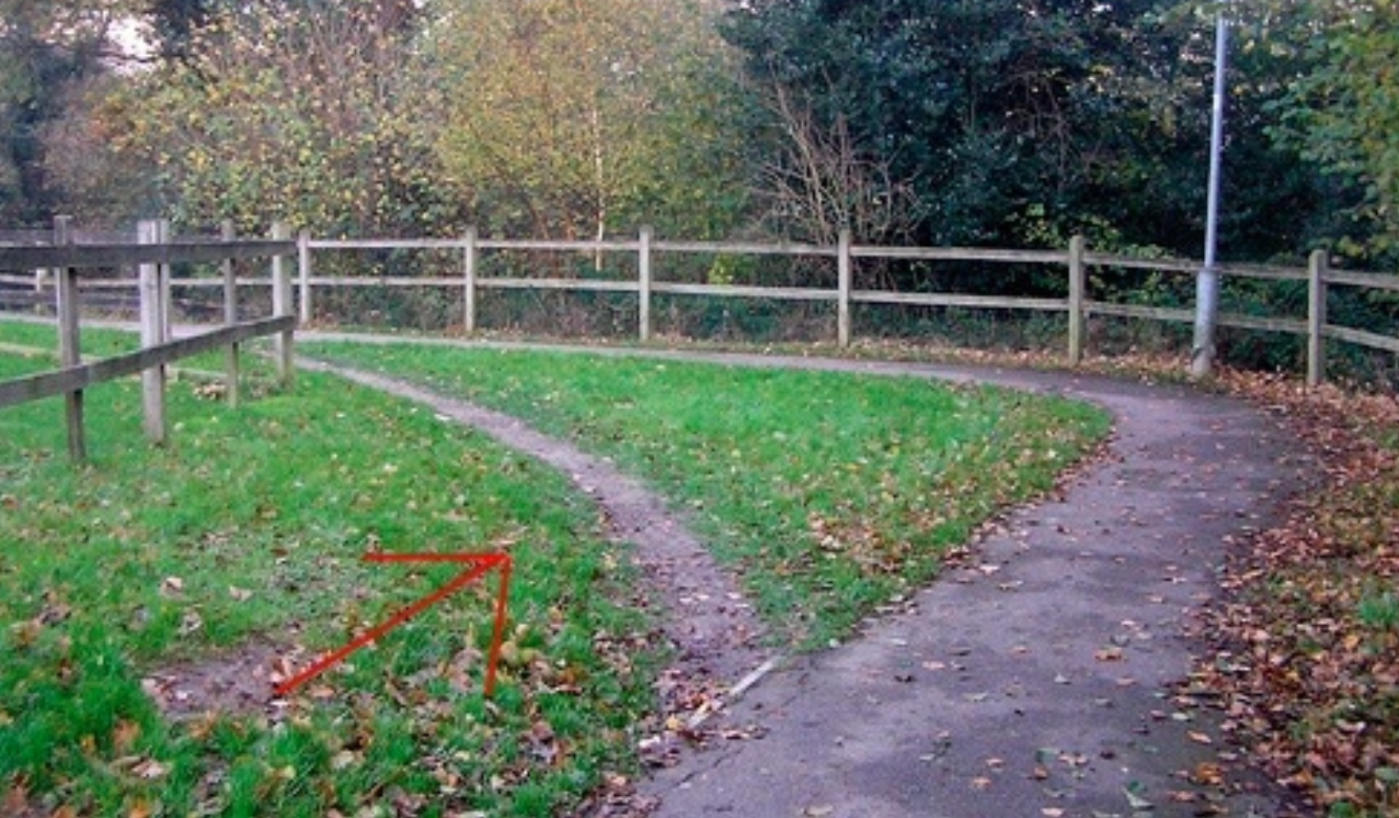

Slide 10
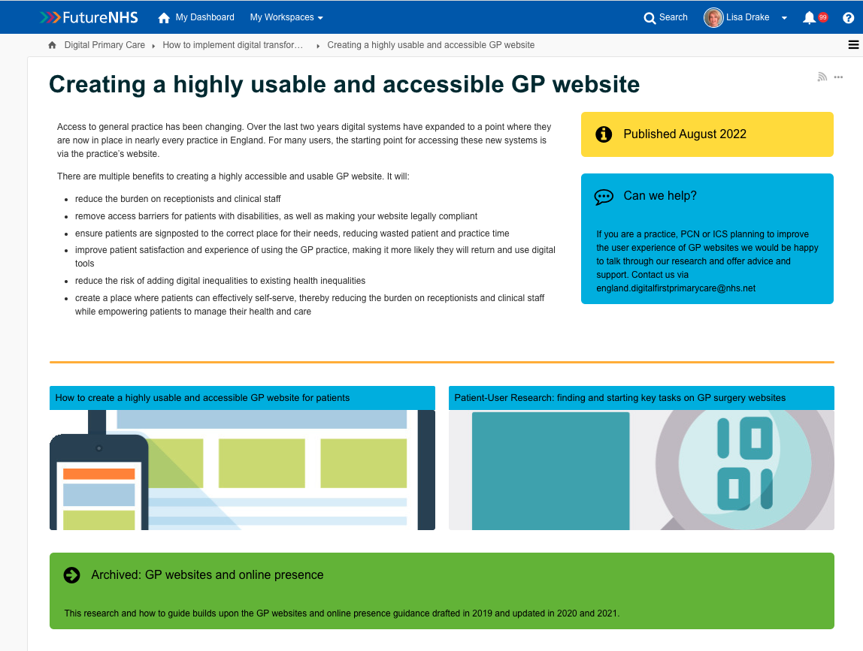

Slide 11
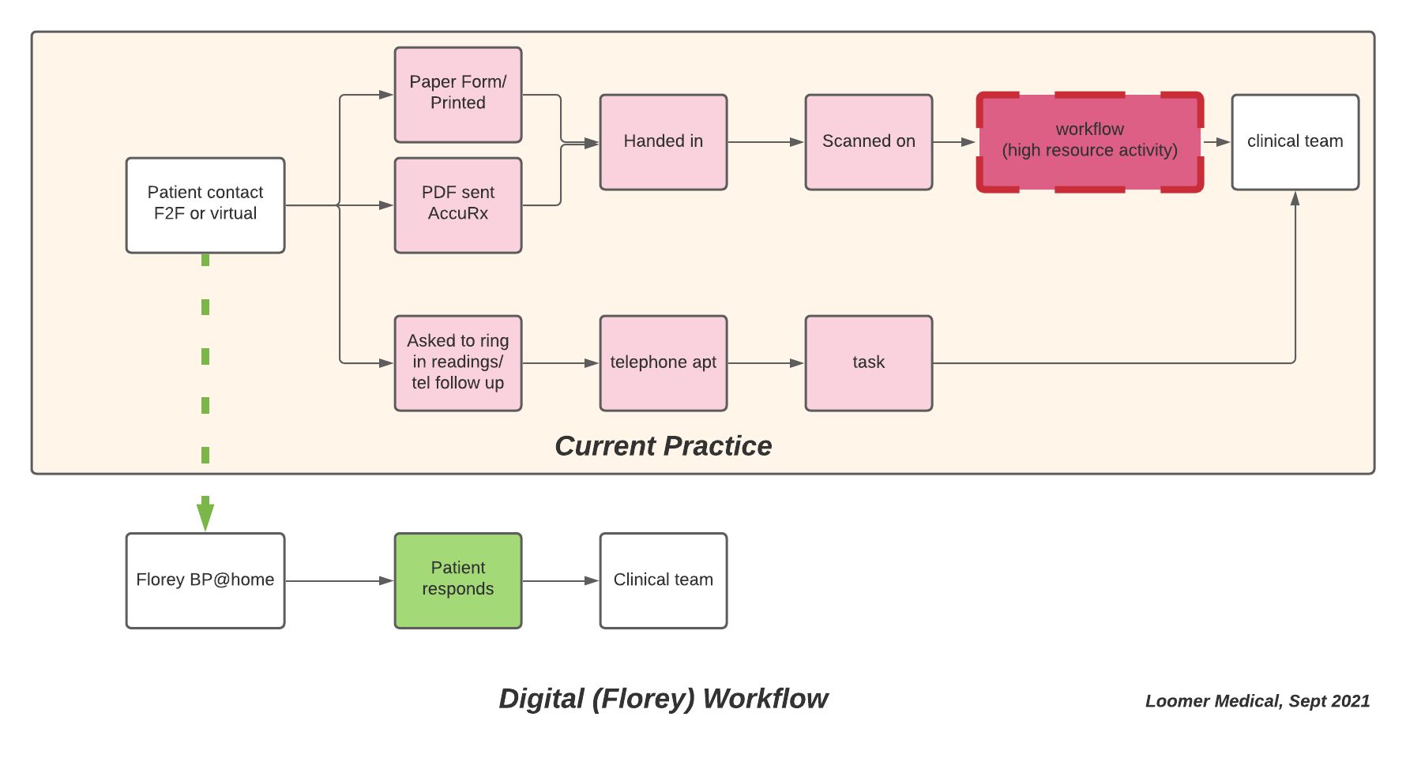
Working Lean

Slide 12
Cloud Telephony - Summary
Hosted on the internet - does not require site dependent hardware
Configurations can be easily changed via a web-based configuration portal
Enables remote and hybrid working through soft phones and mobile phone apps
Removes single point of failure and enables speedy disaster recovery
Provides live insights into call flows enabling configuration changes to remove bottlenecks
No restrictions on the number of incoming calls – no more engaged tone for patients

Slide 13
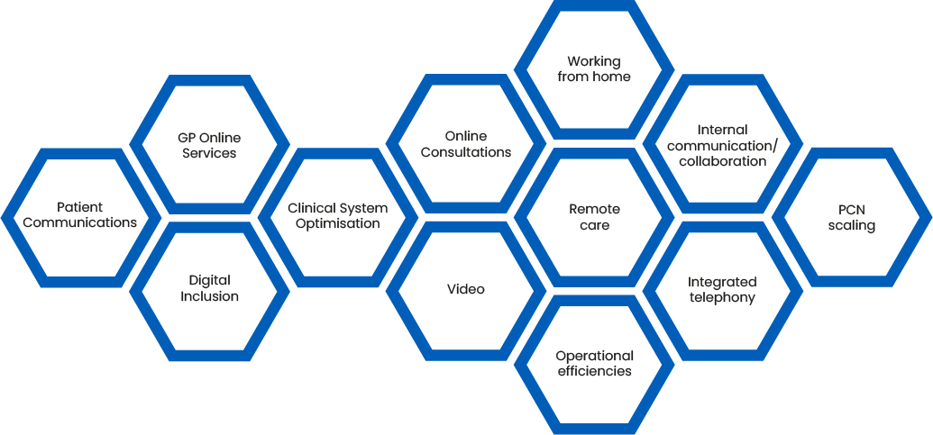

Slide 14
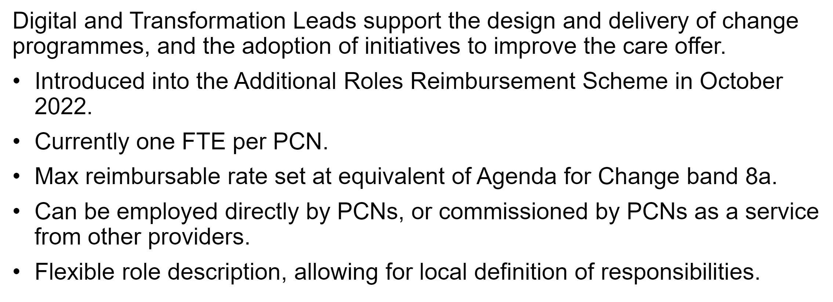
D&T Lead Role: Background

Slide 15
What should they do:

Slide 16
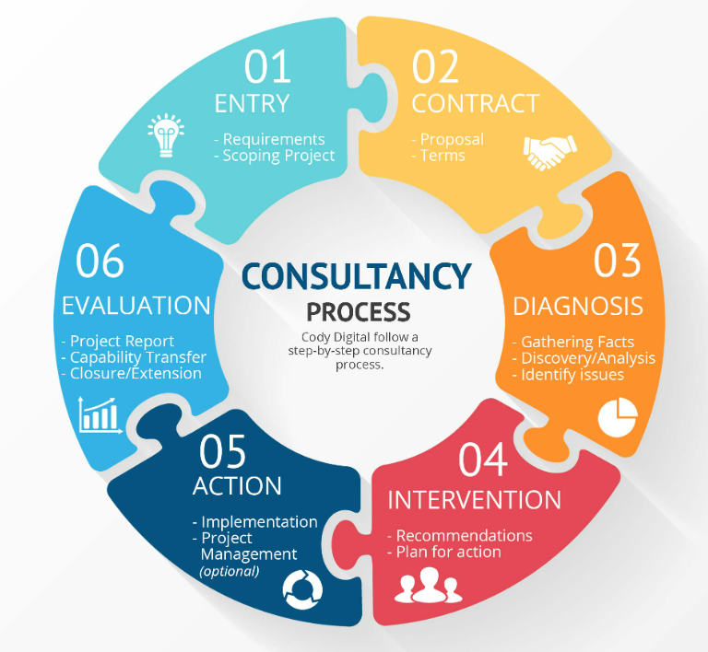
Where to start
Potential data sources:
Demand and capacity tools
PHM data
Workforce / estates planning tools
Where to source support:
Existing practice / PCN / GP Federation staff (development opportunity)
External suppliers (be careful)
Other NHS organisations (NHS Jobs)
Defining scale:
PCN specific
Collaboration at place
ICS

Slide 17
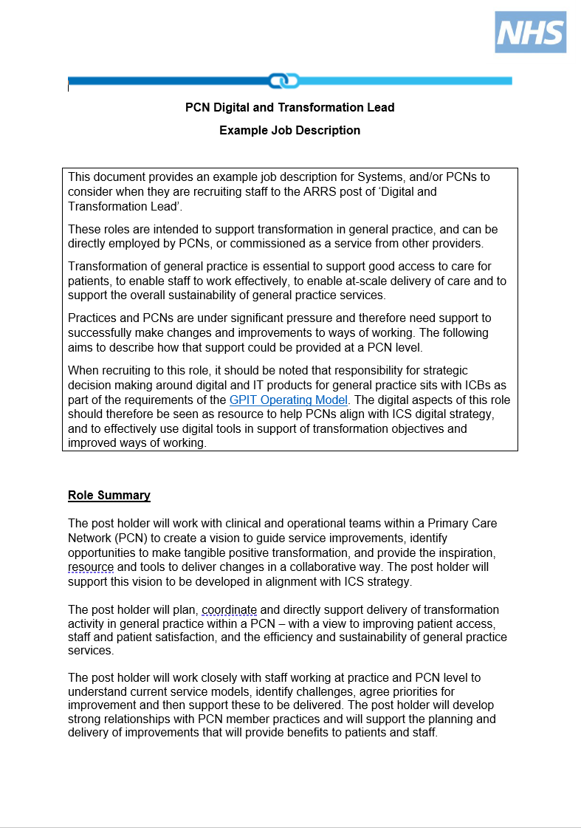
Sample JD

Slide 18
Using a data-led approach to transformation for PCNs
Meera Parkash – Population Health Management, Optum
29th November 2022

Slide 19
Partnering across health and care to deliver population health
National NHS England & Improvement
Population Health Management
Development Programme partner
36
33
147
16m
ICSs participated in Population Health Management Development Programme
Place-based partnerships completed the programme
Primary Care Networks completed the programme
People included in linked data, analytics and insight
We have supported every tier of an integrated health and care system to:
Link local data
Build analytical skills to find rising risk cohorts grappling with social inequality⁴
Design and deliver new models of integrated care focusing on outcomes
Risk stratify elective care backlog
Explore alternative out-of-hospital models
Evaluate potential return on investment of these shifts in care
4. NHS England » 2022/23 priorities and operational planning guidance

Slide 20
PCN Example 1 – Use of linked data set to identify population having an impact on GP demand
Linked data showed that the “Not fit for work” population was one where the greatest impact could be made
Looked at the workforce and other MDT organisations that could help with this chosen population e.g. adult education, community & voluntary sector
ARRS roles that could help with this e.g. social prescribers
Reduce impact on GP appointment and workloads, as not best placed to help with non-clinical topics

Slide 21
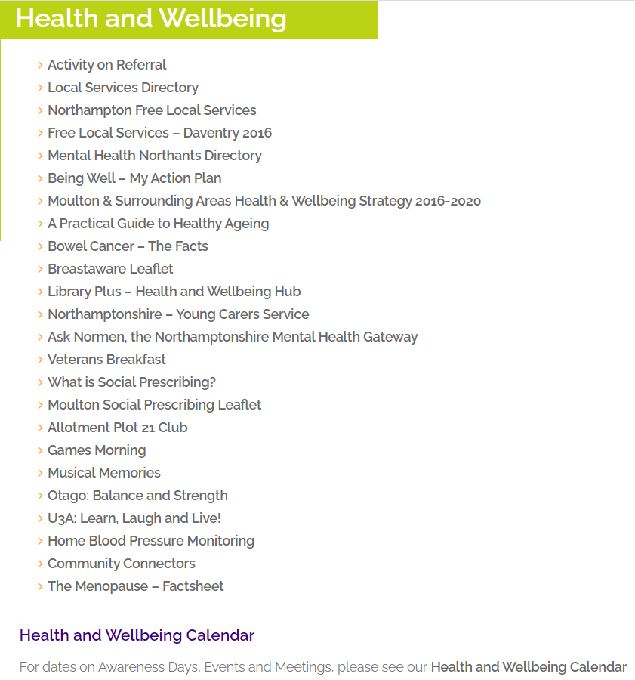
PCN Example 2 – Patient education
PCN selected a population with long-term conditions, and wanted to promote self-awareness through resources
As part of the programme, they realised that it is hard for patients to navigate – where do you go to find all the information?
Created a Health and Wellbeing site on their website. Resources, guides and online webinars (select topics) available for their population
Topics include – social prescribing description, activity on referral, advice for carers, mental health directory/resources and local community activities taking place

Slide 22
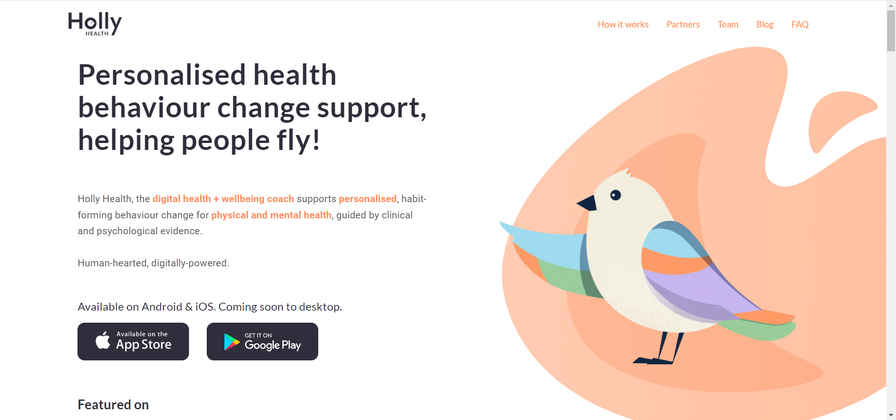
PCN Example 3 – Use of an app to tailor health & wellbeing solutions
PCN chose a cohort of low complexity within the pre-diabetes range (no diagnosis of diabetes) and are living within the deprived areas, and need support for overall health and wellbeing.
95% of the population from a BAME background, language barriers and multigenerational households with carer burden
Deliver tailored messaging for diet (foods likely to be eaten in the cohort) and exercise that can overcome language barrier. Worked with app to provide pictorial messaging and working on translator features in app
Tailored approach with Health & Wellbeing coaches in GP practices as well

Slide 23
Conclusion – thinking of digital transformation in PCNs
WHY do we need to transform digitally: Improve efficiency within our processes, better access and healthcare delivery for our patients/population and optimise workload through better planning and proactive care.
WHAT do we need to transform: Is it access to services/resources for our population, experience of accessing healthcare resources or processes to enable this (working differently, capturing/coding information accurately during interactions).
HOW do we do this: Access to data to enable us to identify where transformation is most needed (priority cohort or process related to cohort); capacity/capability to gather, analyse and evaluate data to enable targeted interventions and plans.

Slide 24
Hear and read from those who have used this approach:
Improving population health on the frontline - a patient's view
“Gloucestershire ICS had developed packs for localities but the programme enabled us to help visualise the data that was meaningful and drove insights, enhancing the way data was presented This gave us a stronger case to successful access funding to develop a PHM Platform using PowerBI.”​
“We need to learn how to access the multitude of our own organizational datasets as a PCN”
“We know that locally we have a number of health inequalities and this project really helped us get to the most vulnerable. ​Once the data showed us there were 102 people at high risk of developing heart failure, we were able to contact them directly and offer them the best support.” ​ - Anne Wray, an Advanced Nurse Practitioner who co-led the project for Bristol Inner City PCN

