Slide 1
Regional PC and PCN Forum #3 : Leadership & Training
South East
7th December 2022

Slide 2
Agenda – 7th December 2022
Time: | Item: | Lead:
12:30 | Welcome and Introductions to the regional forum | Kamal Bahia, PCN Development Lead
12.35 | Collective Leadership | Maggie Woods, Associate Dean Health Education England
13.10 | Questions | Kamal Bahia, PCN Development Lead
13.15 | Menu of Support | Shannon Emberson, NHS England
13.20 | Website for resources and webinars | Stacey Adams, Programme Manager - Redmoor Health
13.25 | AOB, Closing word and next steps | Redmoor Health

Slide 3
Maggie Woods
​ Associate Dean Health Education England ​
OD Consultant for HIOW ICB/S
Supporting Primary Care, Leadership and Organisation Development

Slide 4
Key Points
What is Organisation Development and how can it support your PCN​?
Collective and compassionate leadership as a model for change
Some key points for successful change in PCNs
Signpost you to support offers

Slide 6
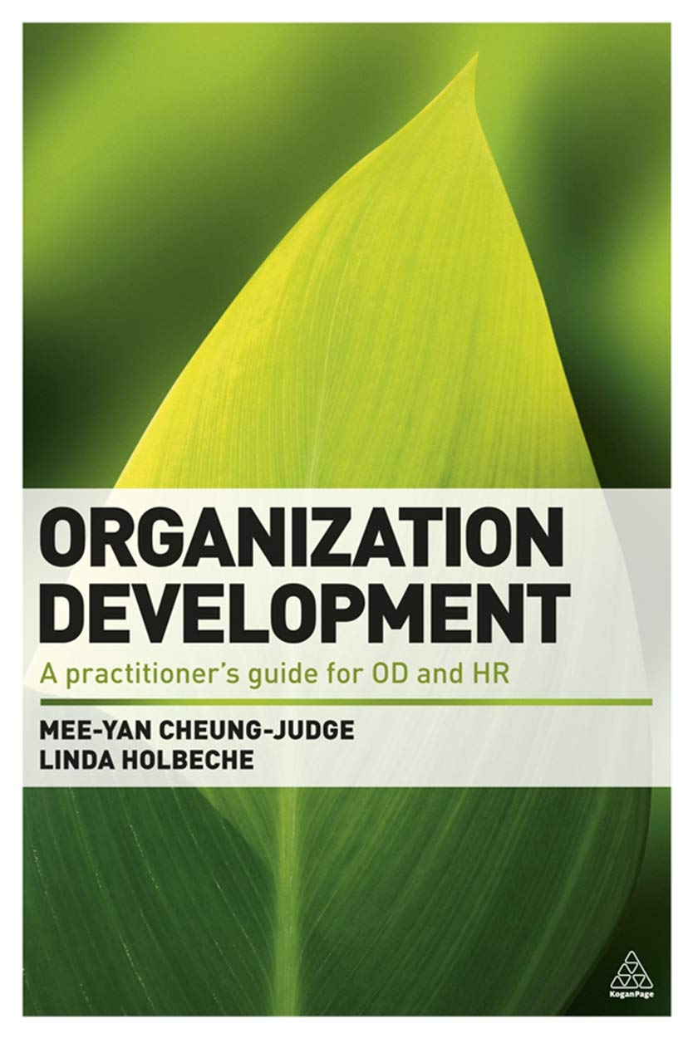
What is Organisation Development ?
The purpose of OD is to improve the quality and safety of citizen / patient care, OD is enabling people to transform systems.
The Leader/ PCN Clinical Director / PCN Manager’s role is to facilitate “the what” , OD’s role is to help with “the how”
It is important that we build on what is working/ already in place

Slide 7
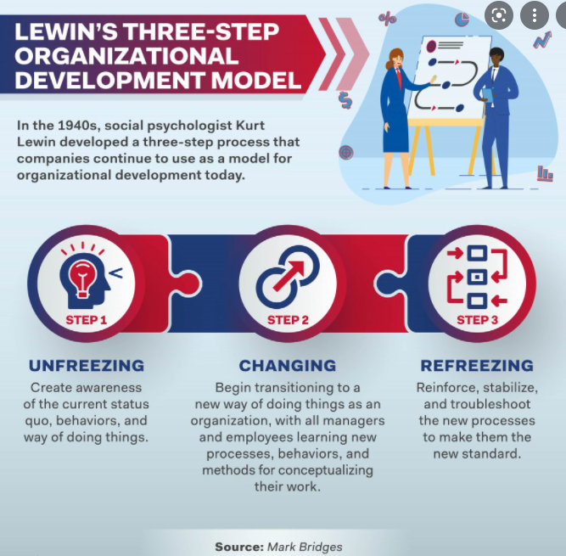
Organisation Development

Slide 8
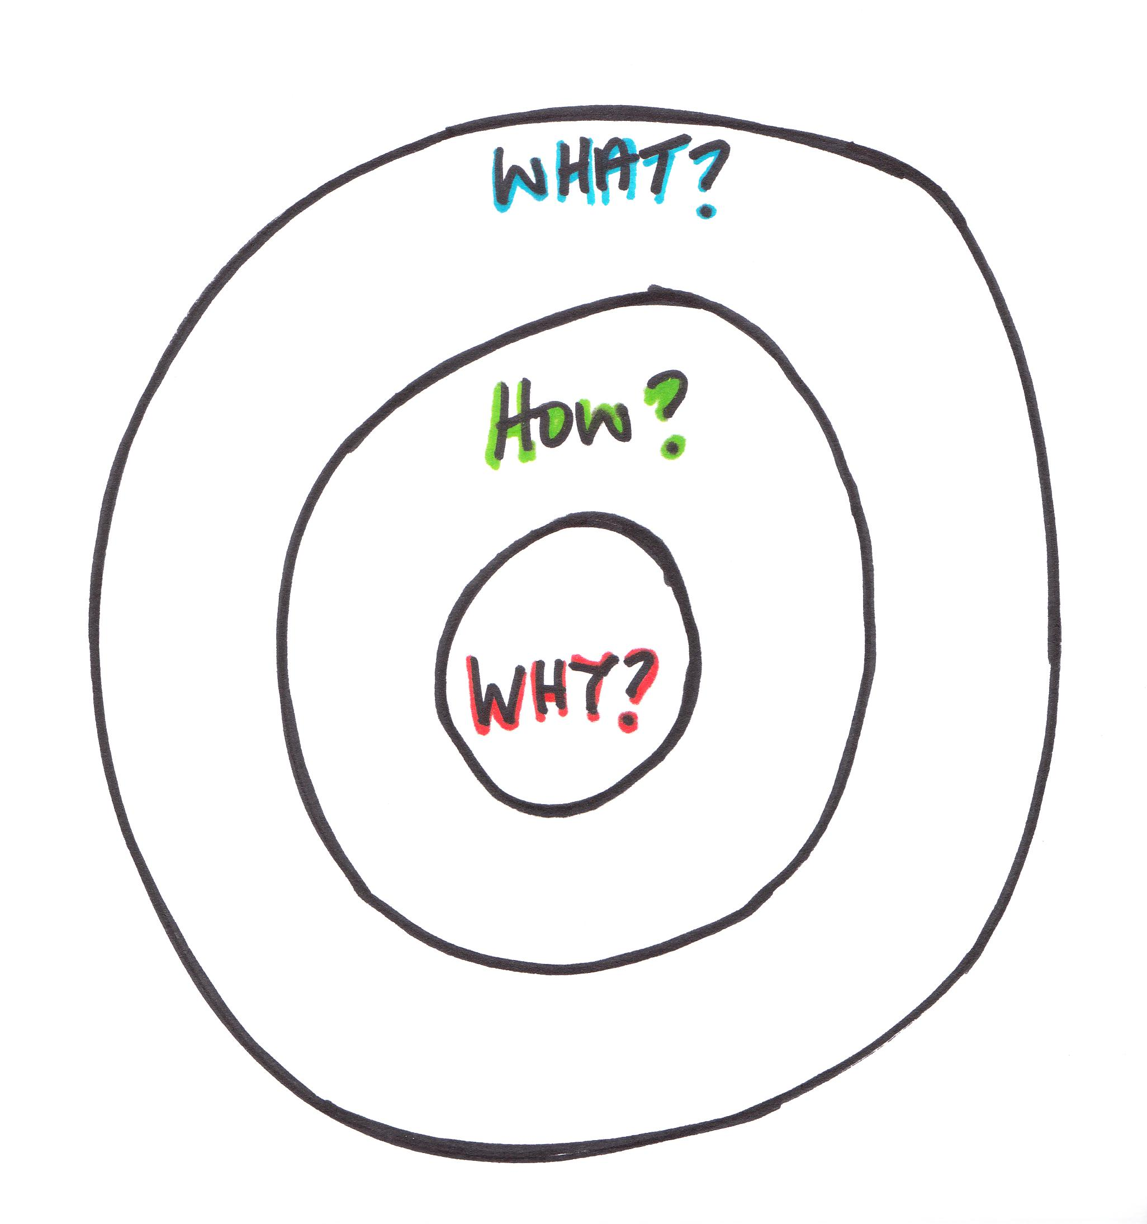
What questions could we be asking ourselves?
What is the purpose ( function/ deliverables) of our PCN/ organisation? The why
How do we work together to develop our culture?, the how
What do we do , deliverables?

Slide 10
OD can support the key elements of working together

Slide 11
Notes:
Health Foundation report

Slide 12
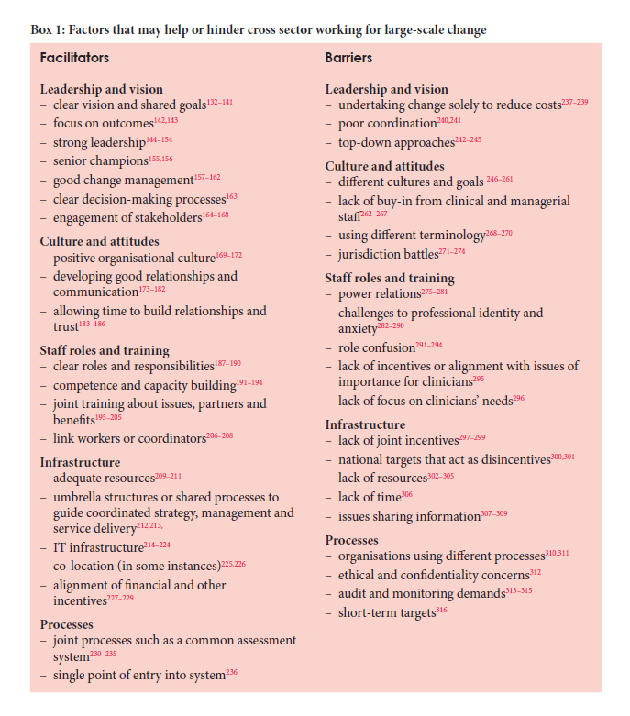

Slide 14
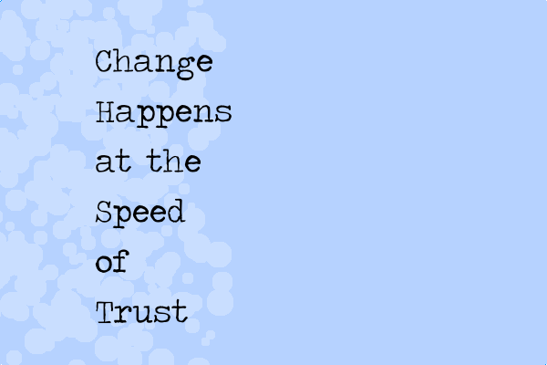

Slide 15
Focus on what is strong/ working

Slide 16
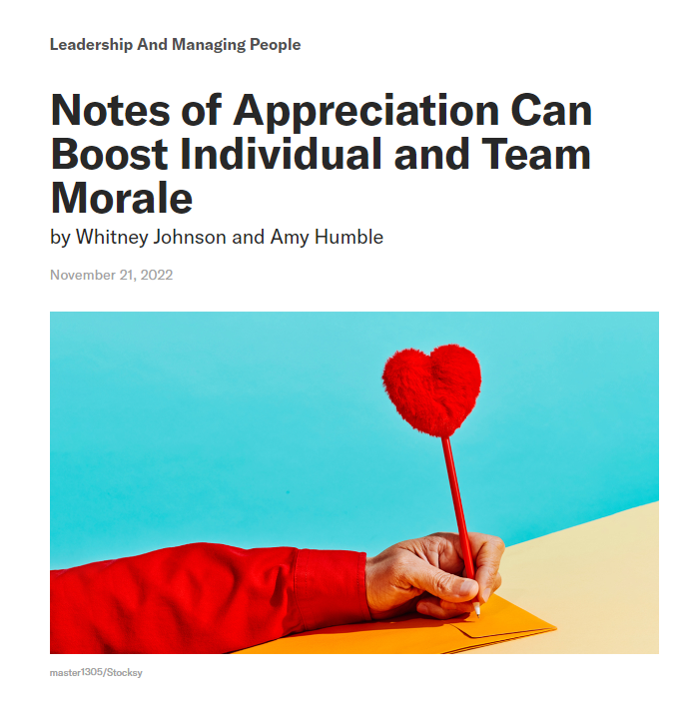
“Positive attention is 30 times more powerful than negative attention,”
If, as a leader, you want to accelerate the growth of your team, you’ll need to play to the strengths of both individuals and the collective.
That begins with knowing not only your own strengths, but also the strengths of each person on your team.
And it can start with a simple, well-considered note of appreciation
https://hbr.org/2022/11/notes-of-appreciation-can-boost-individual-and-team-morale

Slide 17
Focus in what we have in common

Slide 18
Individual Development, for all, including the Clinical Directors and the PCN Managers
Team Development, for the teams within PCN
System Development, bringing CDs and practices together

Slide 19
Possible Interventions
Individual, executive coaching: support and advice re clarity and scope of CD role, ideas for developing and implementing OD interventions, leadership development guidance
Formal and informal courses, 360 leadership feedbacks, reflective learning / groups, topic-based interventions such as influencing / change management skills, appreciative enquiry, system leadership programmes
Team, developing a shared purpose / vison, clear roles and responsibilities, developing ways of working, holding to account, managing conflict / challenging conversations, appreciative enquiry, using tools such as Strengthscope, MBTI, Belbin, storytelling
Practice or PCN, facilitation and development sessions - developing a vision, bringing practices together, effective team working / managing change / conflict , appreciative enquiry/ identifying strengths
System, system leadership interventions and programmes, workshop, world café,

Slide 20
Compassionate Leadership
Compassionate leadership involves a focus on relationships through careful listening to, understanding, empathising with and supporting other people, enabling those we lead to feel valued, respected and cared for, so they can reach their potential and do their best work.
There is clear evidence that compassionate leadership results in more engaged and motivated staff with high levels of wellbeing, which in turn results in high-quality care (West 2021).
Research tells us that inclusive and compassionate leadership helps create a psychologically safe workplace where staff are more likely to listen and support each other resulting in less bullying and better patient outcomes (Carter et al., 2008).

Slide 21
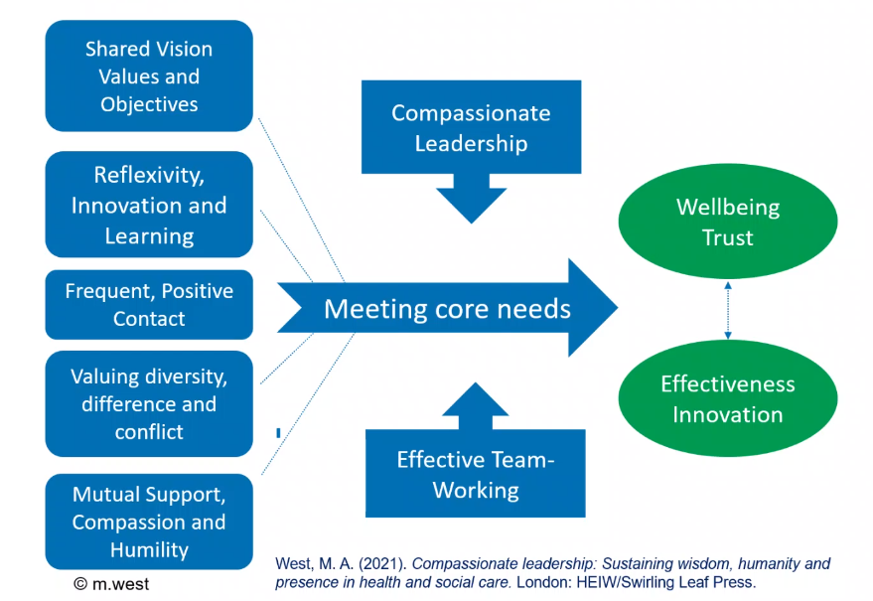
Transformed Teams and Organizations

Slide 22
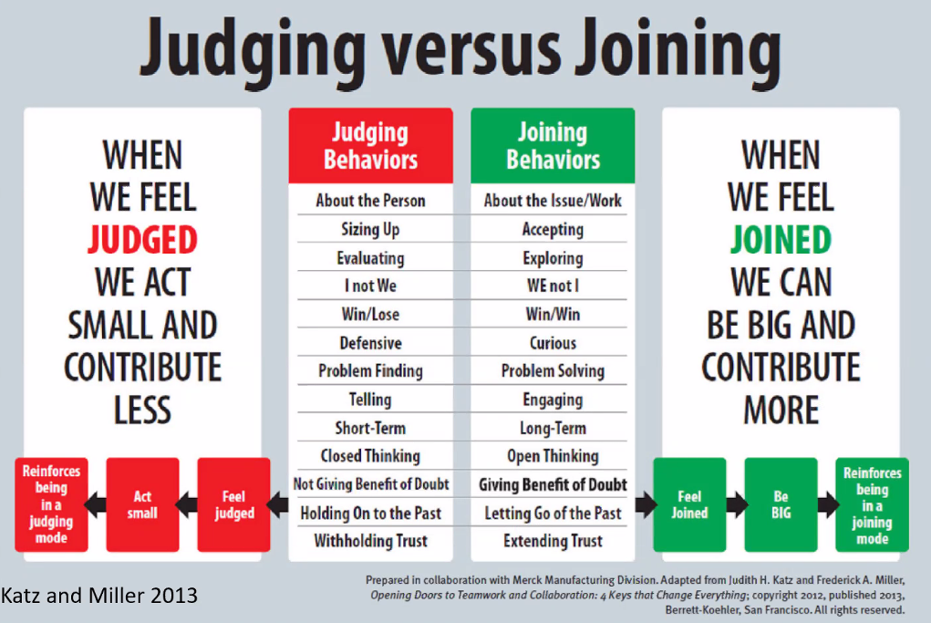

Slide 23
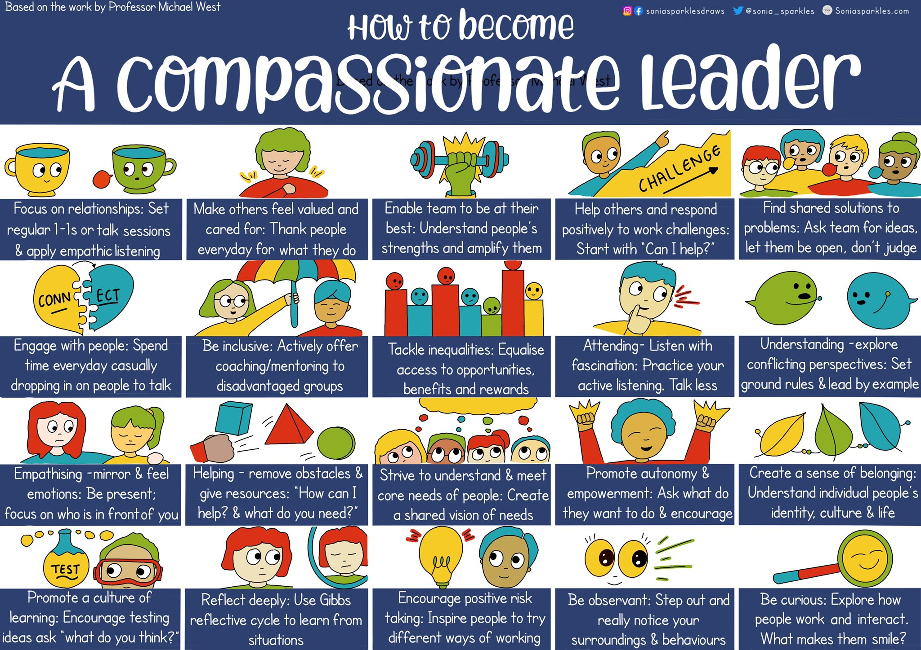

Slide 25
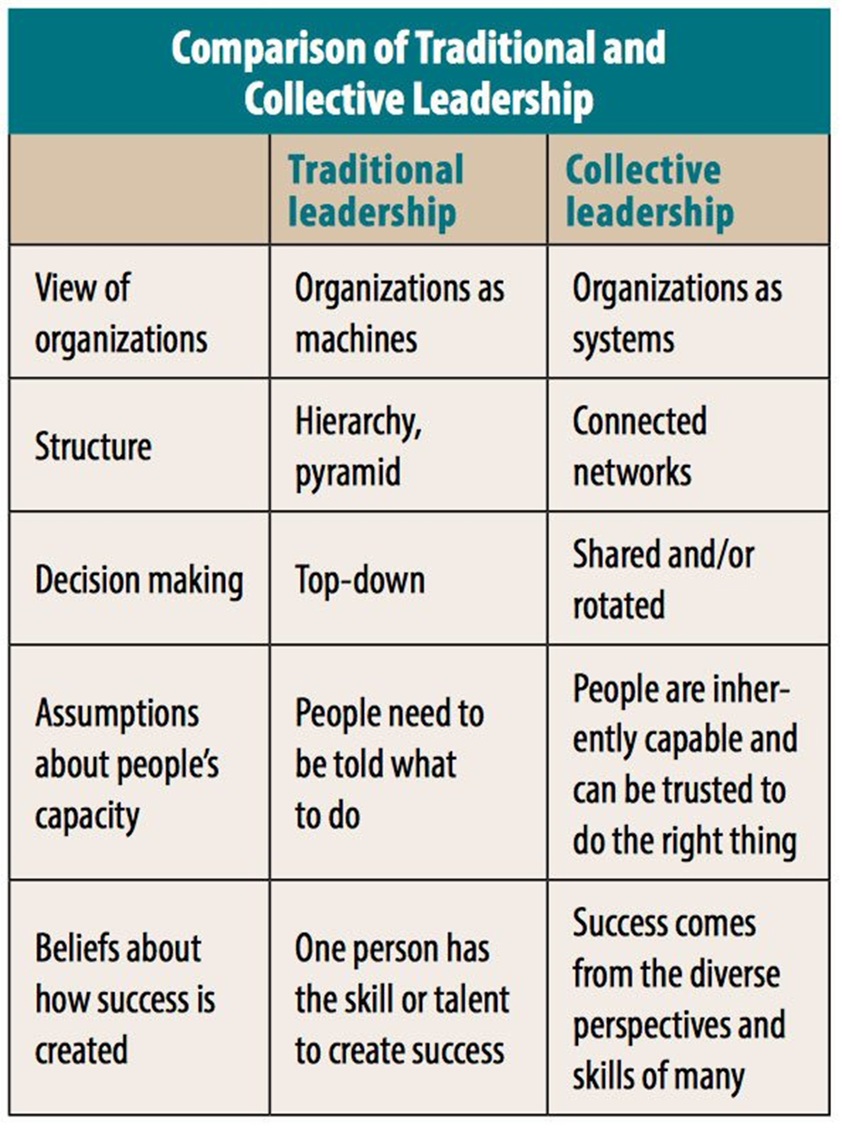
https://nonprofitquarterly.org/2018/02/01/five-elements-collective-leadership/?utm_source=twitter&utm_medium=social&utm_campaign=SocialWarfare

Slide 26
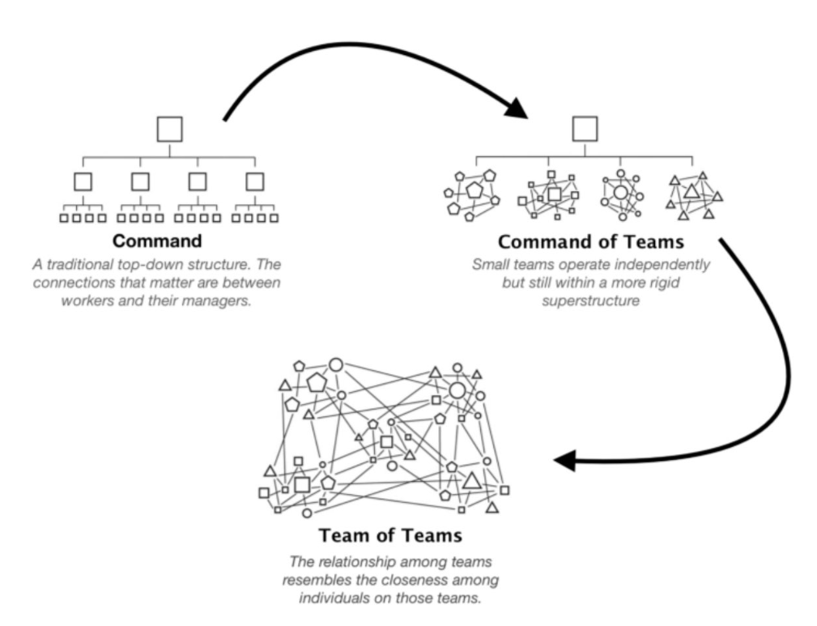
"Leadership is the most powerful factor influencing culture – it determines staff engagement and commitment to high quality care."
Professor Michael West

Slide 27
Successful groups- skills
Build safety
Share vulnerability
Establish purpose

Slide 28
Successful groups- interactions
Profuse amounts of eye contact
Physical touch, handshakes
Short energetic exchanges, no speeches
Lots of questions
Few interruptions
High levels of mixing
Humour
Small attentive courtesies, thank you
High levels of mixing
Physical proximity, often in circles

Slide 30
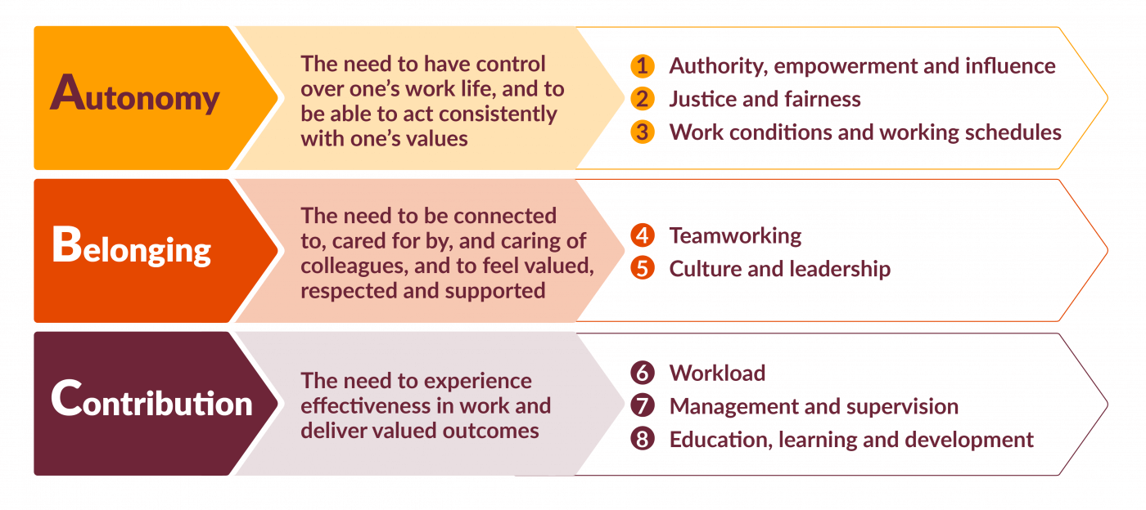
Our Core needs at work, Kings Fund

Slide 32
Key Points
OD is an enabler of change
Focus on the why, the how and then the what
Building relationships is the work, a compassionate and inclusive approach
Focus on what you have in common/ values/ purpose
Focus on what is working well
There are lots of support offers available, ask for advise from your local OD team or leadership academy
Time to think and reflect and share experiences

