Slide 1
INTRODUCING
Manage Patient Registrations: a new feature in the Register with a GP Surgery Service
For TPP practices
Notes:
Add this in the chat and pin it.
Log in to NHS Profile Manager and select Manage Patient Registrations.
Select Yes to turn on Manage Patient Registrations and confirm using the green continue button (please note that it may take up to 24hrs for this change to take effect)
In SystmOne, set up a new task rule through Organisational Preferences so incoming Automatic Registration tasks are assigned to the right team or user group.
Confirm the task process with staff using this TPP video as a guide.
Log in to the Manage Patient Registrations portal to view and manage incoming registration requests.

Slide 2



Housekeeping & Welcome
Stacey Kneen
-
Digital & Transformation Programme Manager
Redmoor Health
GPREG Team
-
NHS England
Notes:
Redmoor
Welcome to our webinar, today’s presenter is me, Stacey Kneen and I’m joined today by our colleagues from the NHS England GPREG team.
First, a bit of housekeeping.
Please be aware that we are recording the webinar today and your videos and microphones have been turned off while we go through the presentation. Please pop any questions in the chat and we’ll go over them in our Q&A section at the end.
After the session today, you will be provided with a link where you can access the recording and other helpful resources.
If you haven’t registered for this session directly, if you joined via a link that was shared by someone else, please do ensure that we have your email address, job title and organisation in the chat so that you receive the follow up information.

Slide 3
Agenda
What is Manage Patient Registrations (MPR)?
Enabling MPR
Changing internal processes
Improving patient information
Support available

Slide 4
What is Manage Patient Registrations?
Manage patient registrations (MPR) is a new service from NHS England.
This new functionality can support 50-65% of patient registrations, being processed through Auto Registration where appropriate, while also providing practices with a managed route to review and process registrations that require additional input.
The service is a portal that lets you:
view incoming patient registrations
review the information a patient gave in the online form
approve or reject patients
view details of patients you approved or rejected in the last 90 days
If you accept their registration, Manage Patient Registrations creates a record for the patient in your clinical system. The registration would be confirmed back to the patient via NHS App message, email, text, or letter.
"Very happy, very easy. One click and the registration is done!"
ACTON LANE MEDICAL CENTRE
Notes:
Manage Patient Registrations, or MPR, is a new NHS England service designed to simplify and speed up patient registrations for practices.
It works hand in hand with Auto Registration and 3rd party applications such as Healthtech1 and GP Automate, allowing straightforward registrations to be processed automatically, while giving practices a managed route to review registrations that need additional checks or input.
The portal allows practices to:
view incoming registrations
review the information submitted by patients
approve or reject registrations
and view registration activity from the previous 90 days.
Once approved, the patient record is automatically created in the clinical system, and they are sent a message to confirm registration.

Slide 5
National criteria for Auto Reg & MPR
MPR criteria
Patients must:
be applying from within your catchment area
be aged 16 or older
have proved their identity to the NHS
are transferring from another practice in England
Auto Reg criteria
Patients must:
meet the MPR criteria plus
details matched with PDS
be aged 18 or older
have no removal codes or safeguarding flags
All other registrations that do not meet the criteria for Manage patient registrations or auto registration from NHS England should be handled using your standard registration processes.
Notes:
There are specific criteria set for both MPR and auto registration, these details are picked up from the information a patient submits online.
For MPR patients must – read list.
For auto registration patients must meet the MPR criteria plus – read list.
Any registrations that do not meet these should go through the practice’s standard registration process.
Patients who fill out the online form will be automatically directed to either Auto Registration, the MPR portal or be sent to your practice through the standard route.
This will depend on which criteria a patient hits.
At the moment, around 30% of registrations will flow through auto registration, while MPR is able to pick up another 20-35% of patients on top of that meaning 50-65% of registrations need minimal practice intervention.

Slide 6
Auto Registration: If a patient meets the national criteria
GPREG submits the registration directly into the GP clinical system (e.g. TPP/S1)
Patient record is automatically:
created
assigned a GP
accepted
de-registration from previous GP & records transfer initiated
Registration is usually completed within ~30 minutes
Patient is automatically notified via NHS Notify
After Registration
Good practice includes:
Automatically signposting the patient to the NHS App
Sending a digital welcome message
Sharing clear “what happens next” information
Ensuring messaging and consent preferences are set in the clinical system
Patient registers via the GPREG Service
GPREG automatically:
checks catchment area
attempts NHS number matching
allows NHS login to pre-populate some details
Managed Patient Registration: If a patient DOES NOT
meet the national criteria
GPREG sends registration details to the MPR portal
Includes information a patient gave in their application
Practice reviews the registration & patient is approved or rejected
If approved, Patient record is automatically:
created
assigned a GP
accepted
de-registration from previous GP & records transfer initiated
Patient is notified when registration is approved via NHS Notify
Notes:
Patients can register via the GPREG service through the NHS website, the NHS App or through links on the GP practice website.
GPREG then automatically checks catchment area, attempts NHS number matching and can pre-populate details using NHS login information.
(CLICK) If a patient meets the national Auto Registration criteria, the registration flows directly into the clinical system automatically. These are generally straightforward registrations and can often be completed within around 30 minutes.
(CLICK) If a patient meets MPR registration criteria, it is sent to the MPR portal for practice review and approval or rejection.
For both Auto registration and MPR, if approved, the patient record is automatically created in the clinical system, assigned a GP and the de-registration and record transfer process is initiated. The patient is then notified of their approval via NHS Notify.
(CLICK) Once registered, good practice is to use this as an opportunity to send a welcome message to explain what happens next and signpost the patient to practice information and the NHS App.

Slide 7
Increasing Digital Uptake
Why it matters:
Higher GPREG use and greater reduction in practice admin burden
MPR relies on strong digital uptake to maximise impact
Supports faster patient onboarding and reduced 111 enquiries
What practices should do:
Use the GPREG enrolment URL as the main digital link on the website
Targets and expectations:
Digital uptake = GPREG submissions / total registrations from all channels
National target of a fully digital patient registration process by March 2027
Notes:
Let’s talk about increasing digital uptake as it’s key to getting the full benefit of GPREG and MPR.
The more patients who use the online registration route, the greater the reduction in manual administration for practices.
It also supports faster onboarding for patients and can help reduce avoidable 111 or practice enquiries about the registration progress.
Digital uptake is measured by comparing GPREG online submissions against total registrations from all channels.
Adopting Manage Patient Registrations supports the wider national direction of travel towards fully digital patient registration processes. As practices embed the service into day-to-day workflows and make full use of the functionality, registrations submitted outside of digital routes can also be added manually into GPREG, helping to support this.
This approach helps create a more consistent and efficient registration process, improves data quality and enables practices to benefit from a single, streamlined pathway.

Slide 8
Benefits of MPR
Key benefits:
Free for practices
Currently supports 50-65% of patient registrations
Less manual workload for practice teams
Higher proportion of registrations completed in under 30 minutes
Simple, consistent experience for patients across England
Long-term vision is for all registrations to move through this digital process
"We love this new way of registering patients. We feel it is so much easier than the other ways we register patients. We like how it comes into S1 as a task. We just feel like it’s a really smooth process. It’s brilliant."
NEWCASTLE MEDICAL CENTRE
"Easy and slick, no complaints on that part. Email registrations are a pain..!"
COASTAL VILLAGES PRACTICE
"MPR exceeds our expectations. I am the one who does all our registrations, and I am having a blast."
THE TRINITY MEDICAL PRACTICE
Notes:
MPR provides a number of benefits for both practices and patients.
It is free for practices and can currently support 50-65% of patient registrations through a more automated process, and the aim is for this percentage to increase further with improvements made over the coming months.
This reduces manual admin, speeds up registration times and creates a more consistent experience for patients. Many registrations can be completed in under 30 minutes.
As you can see from the feedback, it’s been very well received by practice staff.

Slide 9
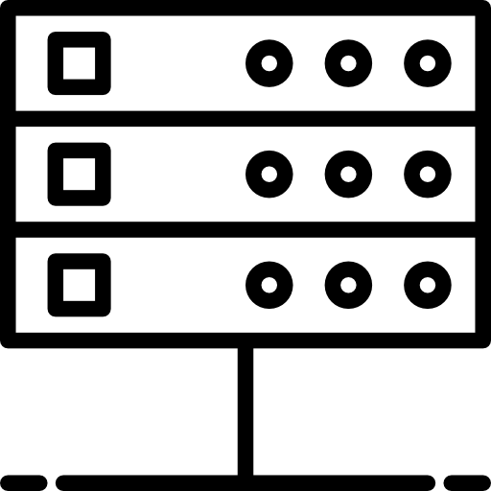





A reminder of the GPREG Core Service
Benefits
IMPROVES DATA QUALITY
INTEGRATES WITH NATIONAL SERVICES
SUPPORTS CATCHMENT AREA CHECKS
95% Spine (PDS & NHS Number) match success rate
Secure access through NHS login
Available on Find a GP page & NHS App
Integrated with eDEC to support practice catchment area policy
Practices are still in full control of accepting or rejecting registrations
Catchment hard block
PROMOTES ACCESSIBILITY
REDUCES ADMINISTRATION
COST REDUCTION
Meets web accessibility standards
Compatible with browser translator services
New PRF1 form, replacing the GMS1
Reduces PCSE exceptions by up to 60%
Registration processing time
Notify a Patient sends patient registration confirmation
Free to use
Centrally provided by NHS England at no cost to practices
The service complies with:
WCAG AA accessibility standard NHS England Primary Medical Care Policy and Guidance Manual (PGM)
Notes:
GPREG as a whole provides a number of wider core service benefits alongside MPR.
It improves data quality through NHS login verification and high NHS number matching success rates.
The service integrates with national NHS services, including the NHS App and Find a GP.
It also supports catchment area checks through eDEC, while still allowing practices to remain in control of accepting or rejecting registrations where appropriate.
The service promotes accessibility by meeting web accessibility standards, supporting browser translation tools and replacing the older GMS1 form with the PRF1.
Overall, GPREG helps reduce administration, lower processing time and reduce costs for practices, while remaining free to use through NHS England.

Slide 10
Approving or rejecting patients
Approving a patient
The registration will automatically be accepted once you approve a patient. A record will be created in your local clinical system and should appear in about 10 minutes. This includes GP Links and SNOMED encoding.
A PDF of the patient responses will also be attached to the record.
Rejecting a patient
The registration will not be processed. You will be asked to choose a reason for rejecting the registration. These reasons align with NHS England policy and legislation.
The service does not tell the patient if they have been rejected from your practice. You will need to follow your existing practice processes. This includes contacting the patient and telling them the reason you have rejected their application.
Useful guidance
This is the national guidance on rejecting registrations
Reasons you can refuse to register a patient - legislation.gov.uk
Rejecting a registration - NHS England Digital
Notes:
When a practice approves a patient through MPR, the registration is automatically accepted and a patient record is created in the clinical system, usually within around 10 minutes.
This includes GP Links, SNOMED coding and a PDF copy of the patient’s submitted responses attached to the record.
If a registration is rejected, the practice must select a rejection reason. Useful national guidance is available on this slide covering valid rejection reasons and the formal rejection process.
The system does not automatically tell the patient they have been rejected, so practices must continue to follow their usual process for contacting the patient and explaining the reason.
A note for patients who have been approved through auto registration. Practices cannot reject patients who have already been successfully auto registered. However, if concerns arise after registration, practices will just need to follow the normal patient removal process.

Slide 11
Viewing approved or rejected registrations
You will be able to see registrations you approved or rejected in the last 90 days.
Approved registrations
Approved registrations will show:
who approved the registration
when it was approved
details of the patient's registration application, contact details and home address
Rejected registrations
Rejected registrations will show:
who rejected the registration
when it was rejected
the reason for rejecting the registration
details of the patient's registration application, contact details and home address
Notes:
Practices can also view registrations they have approved or rejected within the last 90 days.
Approved registrations will show:
who approved the registration
when it was approved
and the patient’s submitted details, including contact information and address.
Rejected registrations will show:
who rejected the registration
when it was rejected
the rejection reason
and the patient’s submitted information.
This provides a clear audit trail and helps practices review previous registration activity if needed.

Slide 12
Patients with SAS flags or removal codes
Those patients who have been removed form another practice for either:
An irretrievable breakdown of relationship, or
Allocation via the Special Allocation Scheme (SAS)
-
Patients who are on the Special Allocations Scheme, or who have an immediate or 8-day removal on their record, could potentially come into Manage Patient Registrations if they meet the national criteria.
-
These will be clearly visible in the MPR portal, and you can review and then choose to either approve or reject these patients.
Notes:
Patients with Special Allocation Scheme flags, immediate removals or 8-day removals may still come through MPR if they meet the national criteria. These codes are taken from PCSE.
However, these patients will be clearly identified within the system so practices can review the registration and decide whether to approve or reject it in line with national guidance.
This helps ensure practices still have visibility and oversight for more complex registrations.

Slide 13
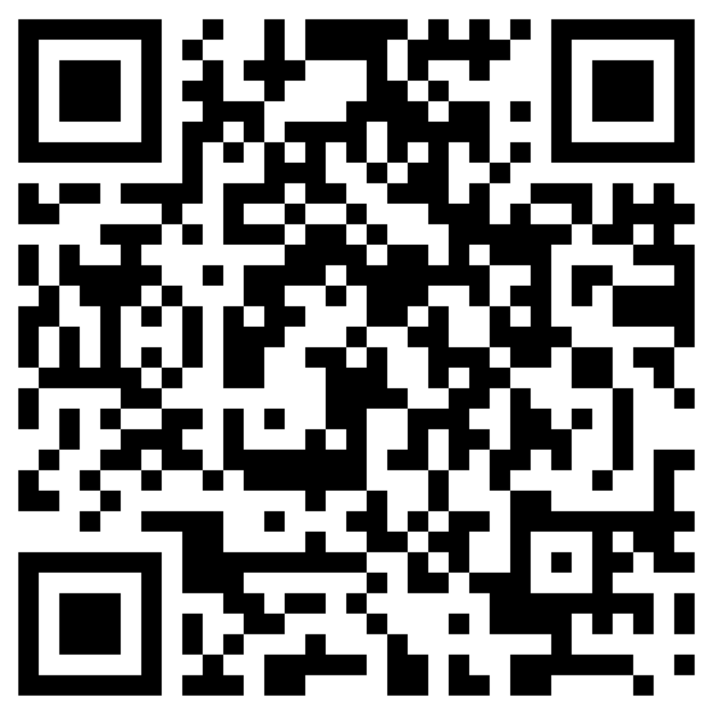
NHS Profile Manager
NHS Profile Manager - NHS
Notes:
To get started, it doesn't matter whether you already have auto-registration in place or if you are completely new to this.
You will first need to access NHS Profile Manager using CIS2 Authentication or Smartcard log in.

Slide 14
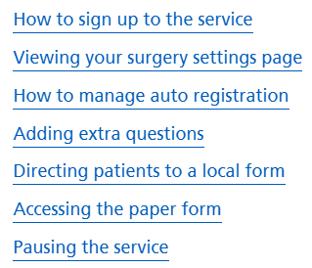
How to Enable MPR
NHS Profile Manager
How to access the service
You will need to log into the MPR service using CIS2 Authentication.
This is what you normally use to log into GP systems as part of your work. You can use your Smartcard to log in if you have one.
Find out more about different ways to access CIS2 Authentication.
Activity roles
You must have the following activity role, which is set by the Registration Authority Manager within the Care Identify Management Service:
B0340 - Register Patients
Find out more about managing activity roles.
If you do not have this activity role on your Smartcard, speak to your Practice Manager.
You can find your registration authority if you do not know it.
Roles that already have this activity code
You will have this activity role as part of your job if you have one of the following roles:
Job role | Code
Clerical Worker | R1720
Receptionist | R1730
Secretary | R1740
Medical secretary | R1760
Officer | R1770
Manager | R1780
Senior Manager | R1790
Notes:
Users must have the B0340 – Register Patients activity role assigned. In many cases, this code is already included within existing job roles such as the ones listed here.
If a member of staff is unable to access the service, they should speak to their Practice Manager or Registration Authority, who can arrange for the correct activity role to be added.

Slide 15
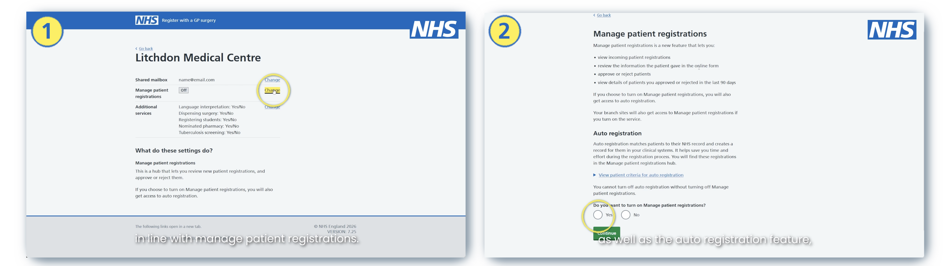
How to Enable MPR
Information for branch surgeries of parent practices
Only parent sites can sign up to Manage Patient Registrations. The parent site will see additional information to show which practice a patient is registering at and the branch site will be able to view their own registrations. Speak to your parent practice to find out if they are using the service.
Notes:
In NHS Profile Manager, log in to the self-enrolment portal.
Select the change link next to Manage Patient Registrations.
You can then review the information about the service, which includes all of the information we’ve just gone through.
Select Yes at the bottom of the page to turn on Manage Patient Registrations and confirm by using the green continue button.
Just a note here that only parent sites can sign up to MPR, however the branch site will be able to view their own registrations and the parent practice will have additional information to show which practice a patient is registering at.

Slide 16
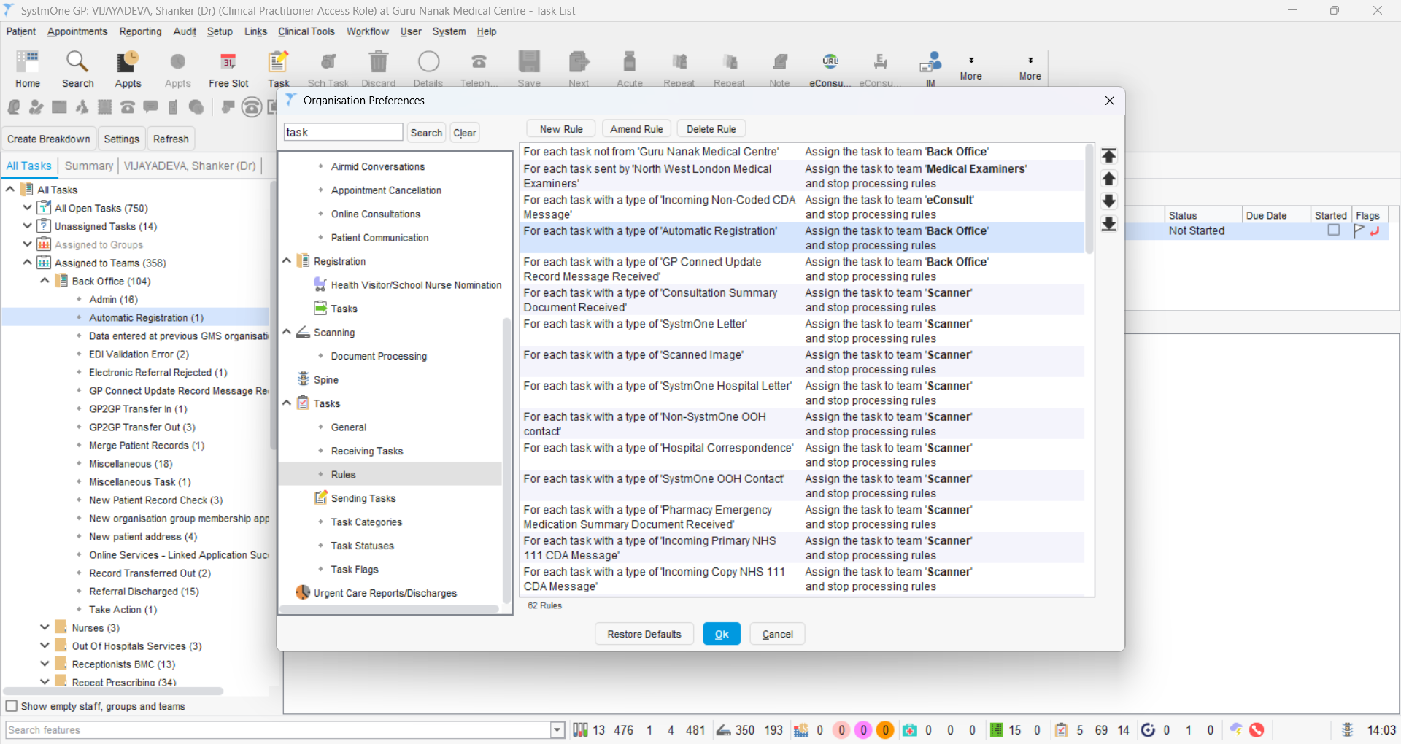
Add a New Tasks Rule via Organisational Preferences to manage incoming ‘Automatic Registration’ tasks
Notes:
Once enrolled, you will need to add a rule in SystmOne to create a task for Auto Registration.
You can do this by going into the organisation preferences and adding a new rule.

Slide 17
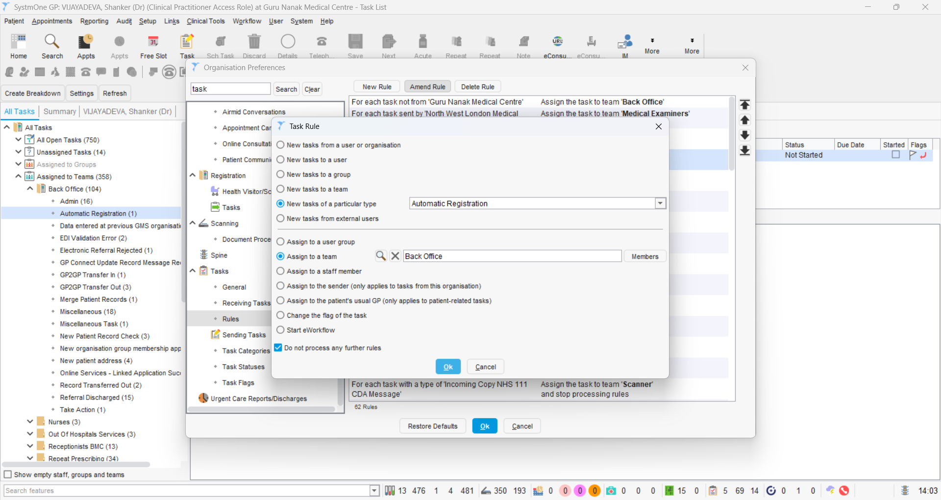
Assign tasks of ‘Automatic Registration’ type to a particular Team (or User group if not yet switched to Teams)
Notes:
Follow these instructions for automatic registration and assign to a team.

Slide 18
Consider moving new Task rule into most optimal place in Task rules order
Notes:
Once complete, it should then appear on your list of rules.

Slide 19
How to Enable Auto Registration in TPP
TPP Guidance Video for Auto Registrations
Notes:
This video will guide you through the steps to take once a patient has registered through Auto Registration in MPR.
Once you have set up a rule, the task will be assigned to a team and in this video, it shows you how to process this at around 3 minutes into the video.

Slide 20
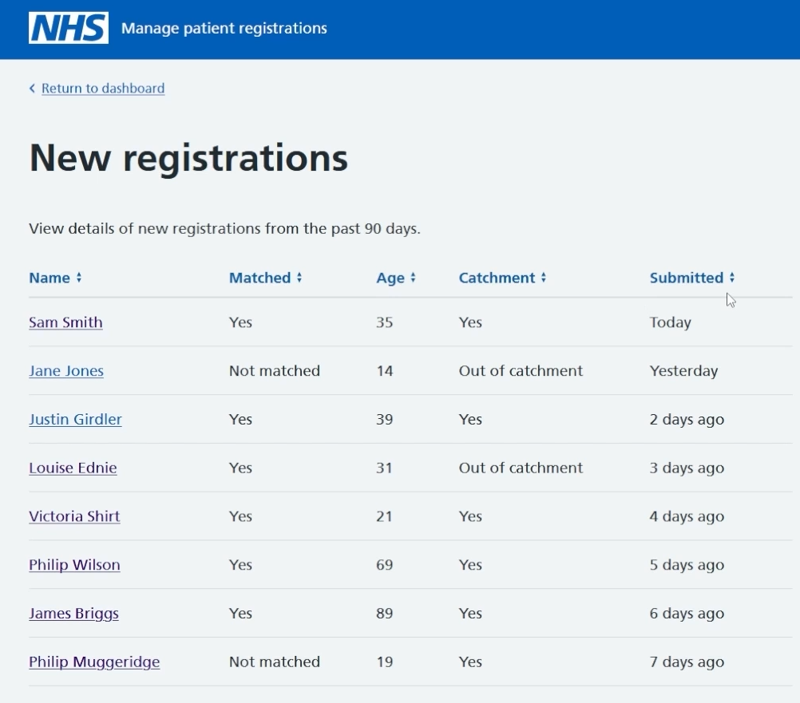
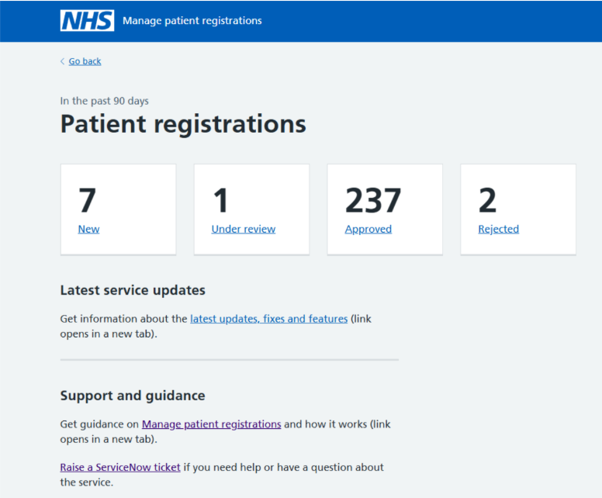
MPR Portal
Manage Patient Registrations portal
Notes:
Once all that is complete, you will then need to log in to the Manage Patient Registrations portal which is a separate web-based platform using the link on this slide, it’s also in the instructions pinned at the top of the chat.
(CLICK) You will then be able to view the registration dashboard that lists patient registration requests from the last 90 days.
Any registrations that do not meet the MPR criteria will not show here and patients who have been auto registered will show in the approved section.
(CLICK) You can then view the new requests received to choose whether to approve or reject them; clicking on the new section gives you a list of patients with an overview of their details.
(CLICK x2) You can use the arrows at the top to sort the columns if you find this easier.
To view a patients registration information, select their name.

Slide 21
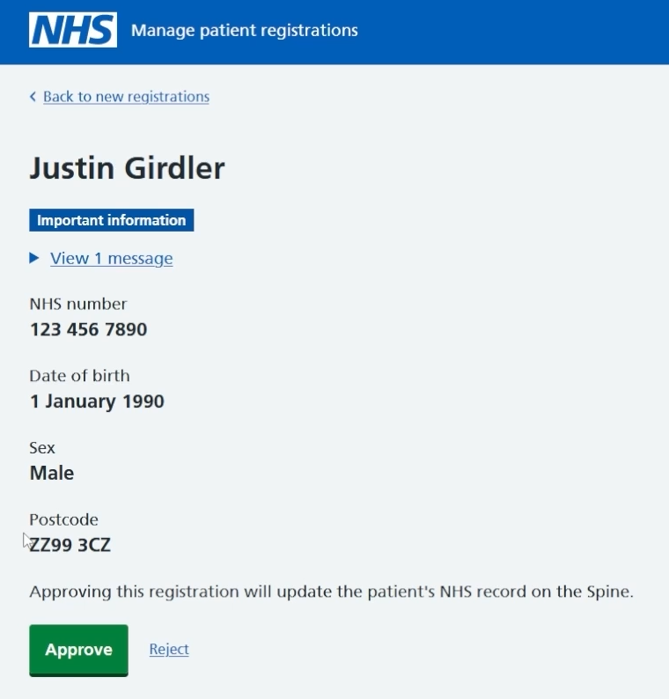
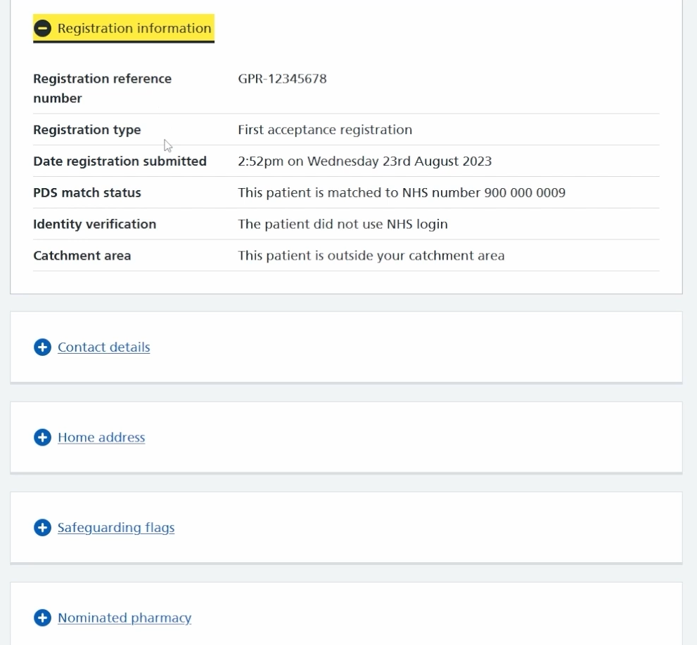
Patient Registration Information
Notes:
You will see in here the information that a patient gave in their registration application.
If you scroll past the approve button you can view more information that the patient included, this is the same information that you would get in an email.
The information is grouped into tables that you can expand and collapse making it easier to view.

Slide 22
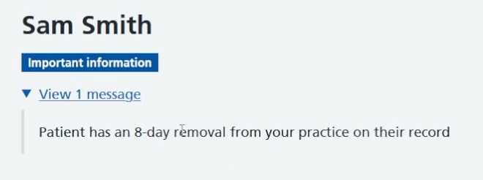
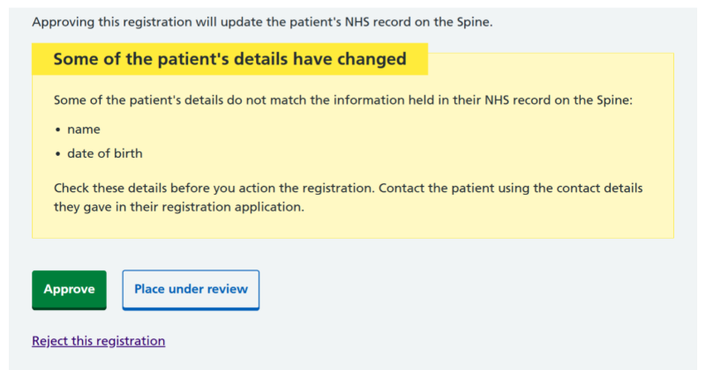
Patient Registration Information
Notes:
Some registrations will highlight important information at the top of the registration. You can see that Sam Smith has had an 8-day removal from the practice that they are registering to in the past.
This page will also display if a patient is a child, out of catchment or registering to a branch site.
(CLICK) In some cases, a yellow box may appear. This indicates that one or more bits of the information submitted does not match what is on the patients NHS record within the spine. At this stage you may place the patient 'under review' whilst you contact the patient or review this information.
Once you have finished reviewing the patient, you can choose to either approve or reject the registration.

Slide 23
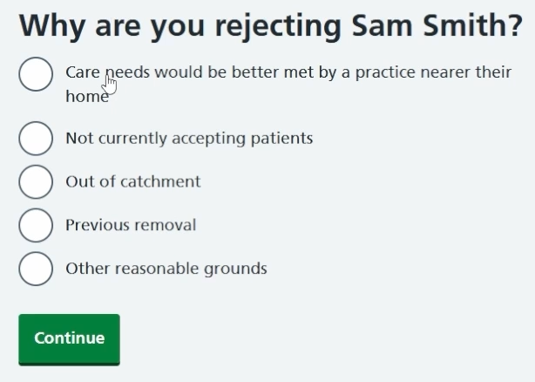
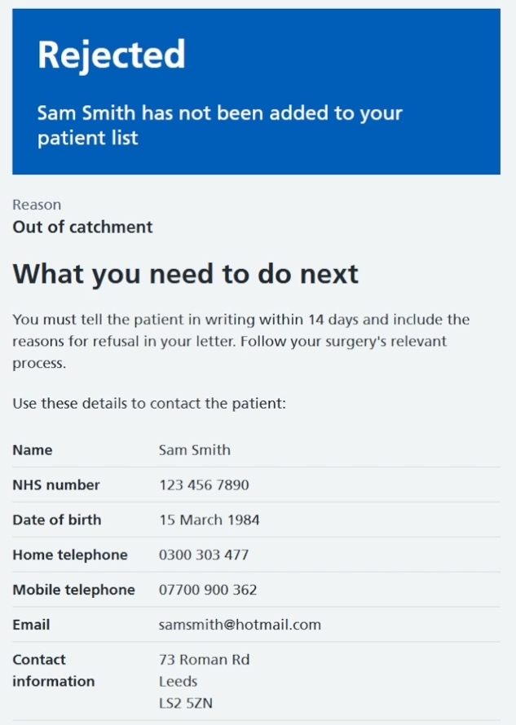
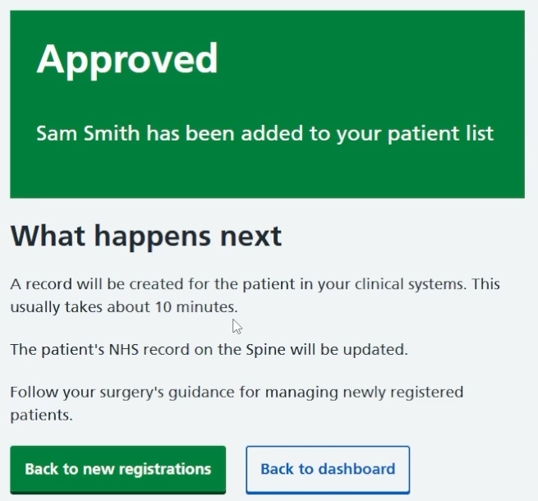
Approving or Rejecting
Notes:
If you accept a registration, you will be presented with this screen to confirm that they have been added to your patient list.
If you decide to reject a patient, (CLICK) you will be asked to submit a reason for rejection and you will then see a screen (CLICK) confirming that they have been rejected and that they have not been added to your patient list.
Remember, you will still need to follow your existing practice processes for rejection and inform this patient in writing.

Slide 24
Managing the service effectively
Nominate GP registration champions in your team
Manage the service through NHS Profile Manager
Update and manage your catchment area
Read best practice on how to update and manage the catchment area for your surgery and learn about how catchment works.
Any change in the boundary/catchment area must be approved in advance by the ICB.
Use PRF1 form for paper applications
Remove all copies of GMS1, legacy webforms and outdated downloadable PDFs.
Learn about the questions asked on the form
Find out why we chose the questions in the online registration process and why that is all that is needed to successfully progress a patient registration.
Learn how to add questions to the form
Notes:
A few things to think about before you set up this new functionality.
Nominate GP registration champions in your team
Select two or three champions in your team to advocate for online registrations and be responsible for reviewing the applications.
Manage the service through NHS Profile Manager
You can change your GP surgery shared inbox, turn on questions and review your services in here.
Update and manage your catchment area
Check that the catchment area for your surgery is correct and make minor changes if necessary. Remember that any bigger changes in the boundary/catchment area must be approved in advance by the ICB. Learn how catchment works using the link on this slide.
Use PRF1 form for paper applications
Replace all copies of the old GMS1 with PRF1 and remove legacy web forms and outdated downloadable PDFs from your website.

Slide 25
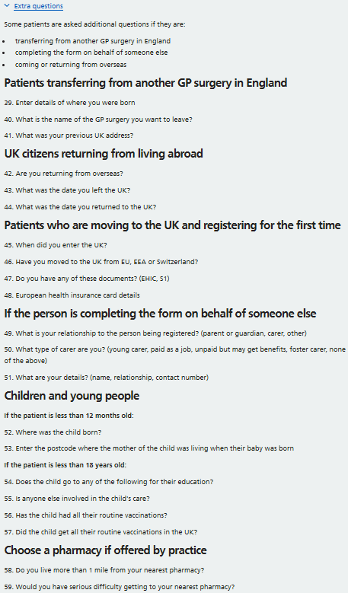
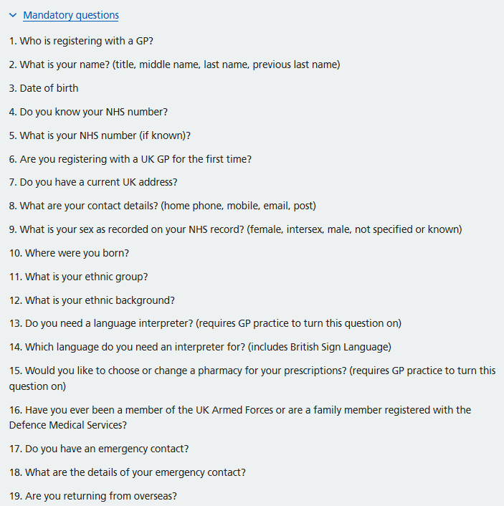
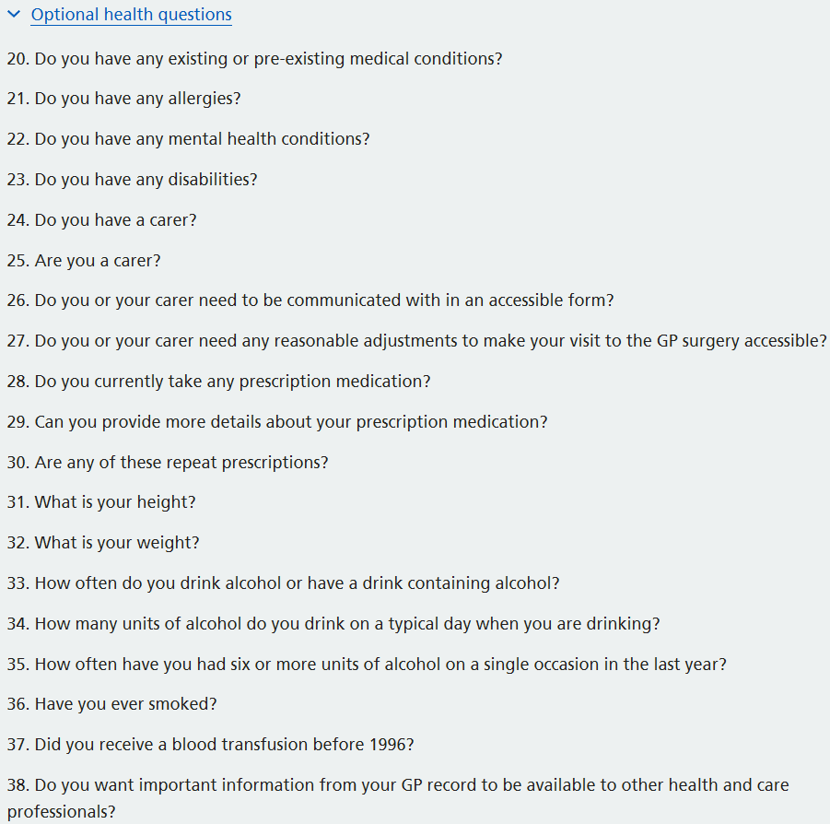
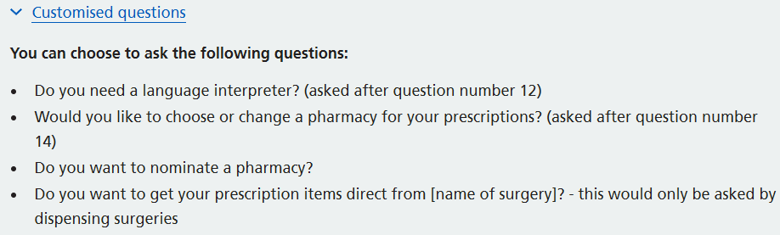
Online form questions
Removing the need for additional forms
Notes:
When a patient fills out the online form they are presented with a set of questions, these are structured into four categories: Mandatory, Optional Health, Extra, and Customised questions.
(CLICK) The Mandatory category contains questions that all patients must answer in order to complete their registration. These questions align with the PRF1 form requirements.
(CLICK) Following this, patients are presented with a series of Optional Health questions. Patients can choose whether or not to answer them.
If a patient is transferring from another GP surgery in England, is completing the form on behalf of someone else or are coming or returning from abroad, patients may be presented with additional Extra questions. (CLICK) These allow patients to provide further information and expand on specific answers where relevant.
Each practice also has access to a number of Customised questions. (CLICK) These questions can be enabled or disabled by the practice, depending on their registration requirements. The customised questions relate specifically to interpreter needs and the patient's nominated pharmacy preferences, including additional dispensing-related information for dispensing practices. Along with specific TB and student questions.
By having these questions in the online form, practices can reduce duplication and avoid asking patients to complete both the online form and separate paper forms.

Slide 26
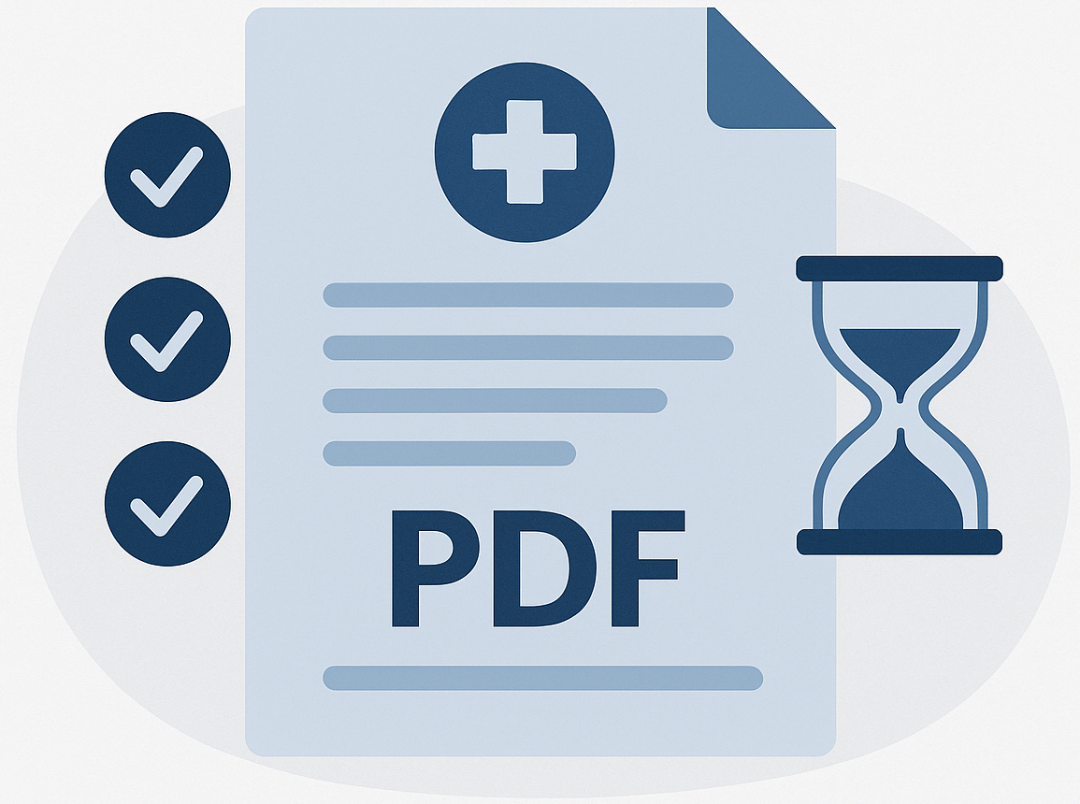
What practices need to review in the registrations
Information that has not been coded via SNOMED will still be captured in the PDF providing the patient has answered it on their submission
The PDF will be attached in the 'Recorded Attachments' section in TPP/S1
If these fields are not blank, you will need to migrate this information manually
  Emergency contact
  Previous GP details
  Any free format fields a patient has completed
    E.g. pre-existing conditions
You can change the named GP that has been assigned by auto registration via the Record section using the Named GP template.
Notes:
Not all information submitted through the online registration form is automatically SNOMED coded into the clinical record. Any non-coded or free text responses provided by the patient will be captured within a PDF attachment.
This PDF is stored in the ‘Recorded Attachments’ section within SystmOne and should be reviewed by the practice as part of the registration process.
Practices may still need to manually enter certain details into the patient record, such as emergency contact information, previous GP details, or free text information like pre-existing medical conditions. Also, depending on your own internal registration process, you may wish to obtain and record additional information than what is already recorded within the online registration form. Practices could utilise other existing digital tools such as floreys and health forms to obtain this information as part of their post-registration process.
Patients are automatically assigned a named GP which you will set up in the SystmOne config, but you still have the ability to change this after the registration has been processed if necessary.
This can be updated within the patient record using the Named GP template in the Record section of TPP/SystmOne.

Slide 27

Changing internal processes
Current process
Registrations reviewed and completed once/twice per week.
Manual registration process for all new patients.
Confirmation needs sent to each patient.
New process
Registrations reviewed and completed every day.
Manual process needed for some patients.
Confirmation will automatically be sent to each patient once accepted.
Clear ownership
Who is responsible for monitoring registrations?
Who picks up exceptions if something doesn’t flow through automatically?
What happens if that person is off?
Notes:
To get the full benefit from MPR, practices may need to adapt their internal processes.
Rather than one person reviewing registrations once a week, many practices move to shared ownership with registrations checked daily by the registration champions.
Having one agreed process and clear ownership is key, including who monitors the online registrations and who covers when those staff are away.
Practices embedding these changes consistently save around 10 minutes per new patient registration.

Slide 28



Redesigning admin roles
Agree which tasks can stop
Be clear about where time should be reinvested
Make sure admin teams are supported
Notes:
This is often a concern for staff, but also one of the most important points. MPR doesn’t remove the need for admin teams — it changes how their time is used.
When MPR is working well, some manual tasks no longer need to happen, such as re-entering information or manually processing every registration. That doesn’t mean admin work disappears, it means time is released for higher-value activities.
That time can be redirected into areas like proactive recalls, QOF work, patient messaging and follow-ups — all areas where admin teams already add huge value but often don’t have enough capacity.
The key is making sure roles evolve alongside the technology by agreeing which tasks can stop, being clear where time should be reinvested, and supporting teams through the change.

Slide 29
Using registration as the start of digital onboarding
Welcome message
Signposting to the NHS App
GP practice website
Notes:
Think about this. Registration is one of the few moments where a patient is actively engaged, making it the ideal opportunity to set expectations and support digital onboarding from day one.
Practices can use welcome messages after registration confirmation to direct patients to key information on the practice website, including how you would prefer them to contact the practice, request appointments, order repeat prescriptions and use online services. You can also signpost patients to the NHS App and encourage them to turn on notifications.
Using registration in this way helps guide patient behaviour early, reducing avoidable inbound calls and helping patients understand the best ways to access support and services.

Slide 30
Improving patient information
GP Practice Website
Social Media
Community Information
Notes:
Registration works best when patients already understand how the process works before they contact the practice. Clear information on the practice website, social media and community information can help shape patient expectations and support smoother registration processes without creating extra work for staff.

Slide 31
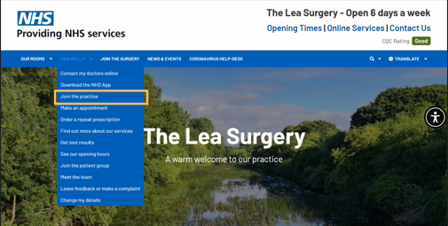
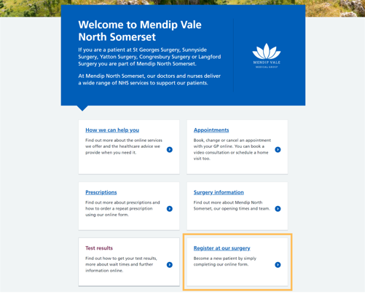
Website
Registration Page Best Practice
Clearly explain the registration process, how long it will take and what will happen next
Provide information for patients registering children or for non-speaking English patients
Let patients out of the catchment area know that they can still register with your surgery
Add a catchment map
Improve visibility of the service on your website
Notes:
These are some examples of how practices can make the registration process easy to find and access from their website. Having a clear and visible “Register with us” section helps guide patients directly to the online registration process.
Registration pages should clearly explain how the process works, how long it may take and what patients can expect next. Practices should also consider including information for parents registering children, non-English speaking patients and patients living outside the catchment area.
Simple improvements such as clear navigation, prominent website links and a catchment map can help reduce confusion, improve patient experience and reduce avoidable calls to the practice.

Slide 32

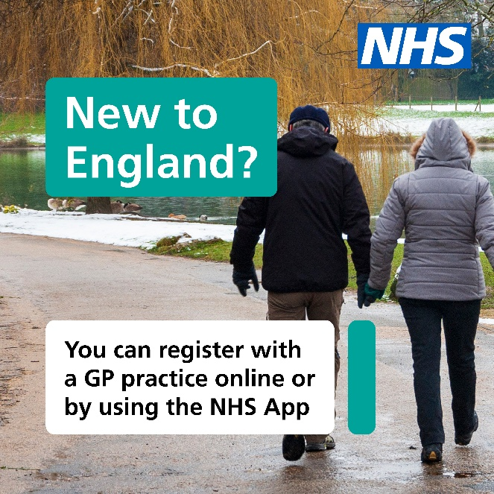
Social Media
Online service makes registration easier for patients
We are using an online registration service called Register with a GP surgery that makes it easy to register with this GP surgery.
New patients just need to fill in an online form to get started. They do not need proof of address or immigration status, ID or an NHS number.
Paper forms are available for people who need them.
The service is designed and run by the NHS. It aims to cut practices’ workloads and make GP registration easier for the public.
You can register with our GP practice online. You don't need to visit us in person, just fill out the digital form. [Register today.]
Notes:
These are examples of social media assets available through the GPREG website that practices can use to promote online registration to patients.
Simple posts like these help raise awareness that patients can register online. They also help reassure patients that ID, proof of address or immigration status are not required to start the registration process.

Slide 33
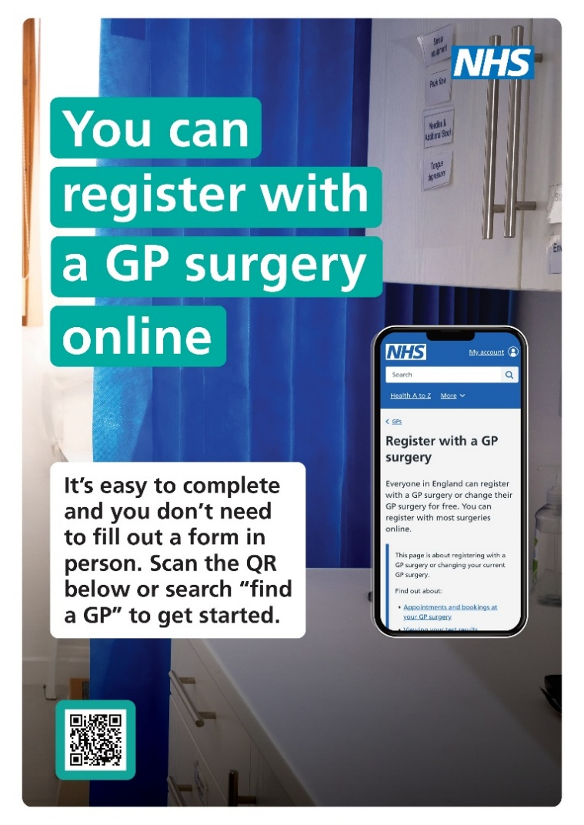
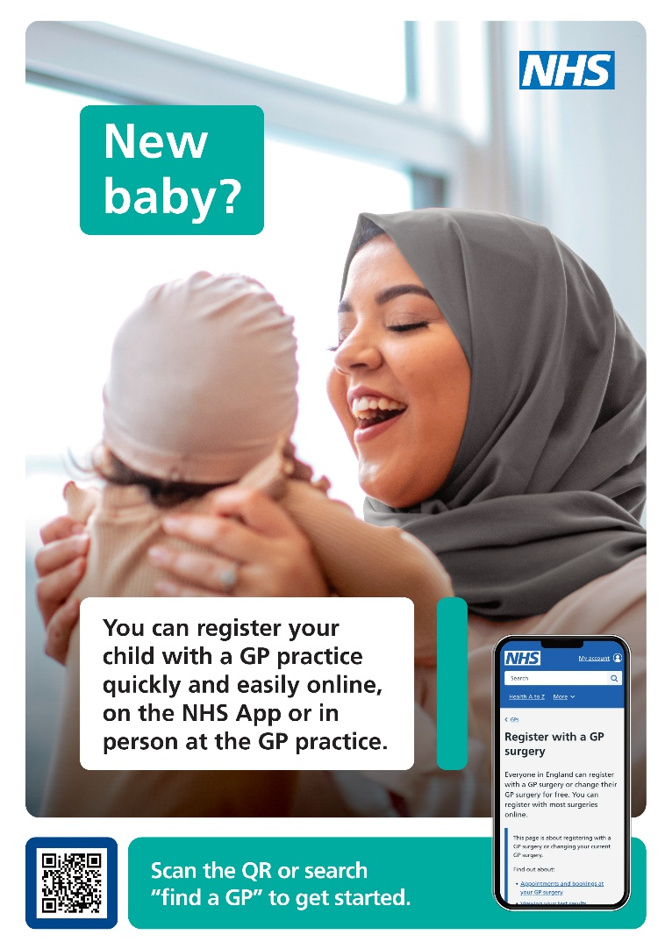
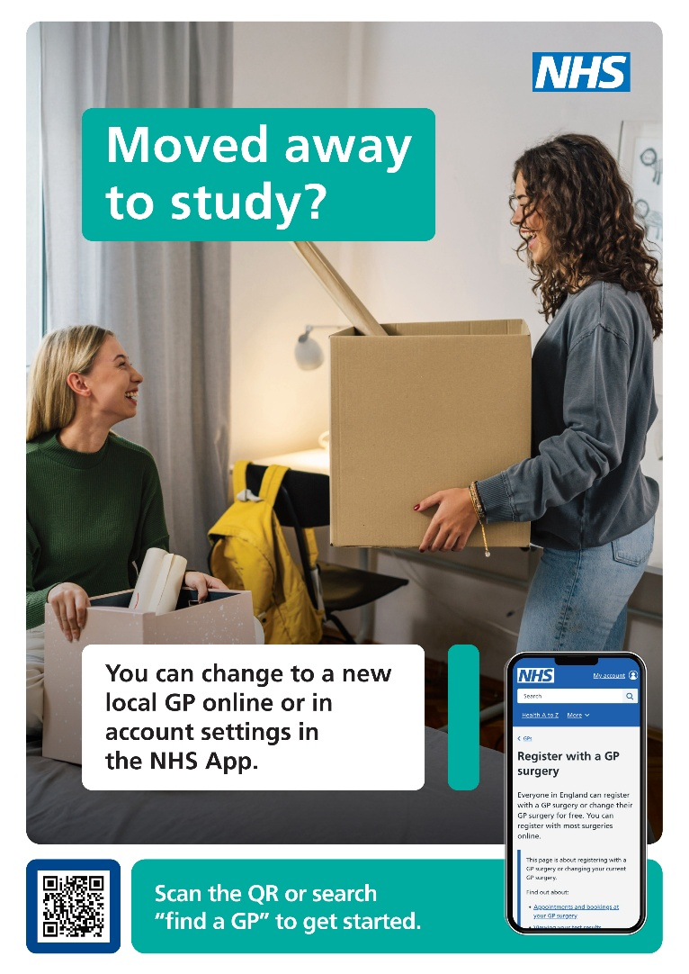
Community
Notes:
Here are some examples of community posters also available through the GPREG website that practices can use to promote online registration in local settings.
Practices should think about where these messages are most likely to reach potential new patients. For example, posters about registering a new baby could be displayed in community centres running antenatal classes, while student-focused posters may work well on university or college information boards.
Other useful locations could include pharmacies, libraries or council buildings. Including a QR code on these posters means patients have instant access to the online form, there is guidance on how to create a QR code for your own practice alongside these assets on the website.

Slide 34

Digital Inclusion
Reception staff available to support patients with completing the online registration form.
QR code available for new patients to scan, providing direct access to the online registration form.
PRF1 paper registration form accessible via the practice website for patients who prefer a non-digital option.
Quick access link for reception staff to print a paper registration form on request.
Notes:
There will always be patients who either cannot or do not want to use digital services, so practices should make sure alternative support is available alongside GPREG.
Practices can encourage digital registration by displaying QR codes at reception so staff can support patients to complete the online form on their own device of on a practice owned device if available.
For patients who prefer paper forms, practices can provide a link to the PRF1 paper form on the website and have a quick desktop link available so forms can be printed when needed, rather than storing large numbers of paper copies.
The PRF1 form should be viewed as a supportive alternative for patients who are unable to use digital routes, while practices continue to encourage online registration wherever possible.
As Manage Patient Registrations becomes embedded into practice workflows, this will help support the wider move towards a more consistent digital registration process.

Slide 35
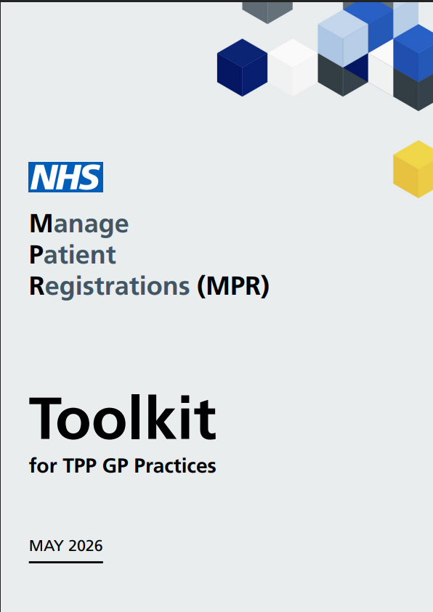
Support Available
Webinars:
SystmOne – 15th July @ 12.00
SystmOne – 21st July @ 13.00
SystmOne – 22nd July @ 12.00
SystmOne – 28th July @ 13.00
SystmOne – 29th July @ 12.00
Drop-in Sessions:
For practices that have questions or would like support with setting up and using this new functionality.
SystmOne – 16th July @ 11.30
SystmOne – 23rd July @ 11.30
SystmOne – 28th July @ 12.30
For more information, resources and access to one-to-one support, visit this webpage.
support@redmoorhealth.co.uk
Notes:
All of the information contained in this webinar along with resources, other webinars, drop-in sessions and one-to-one support information can be found on this webpage.
If you would like any further support to get started, please use this link or email our support team.

Slide 36
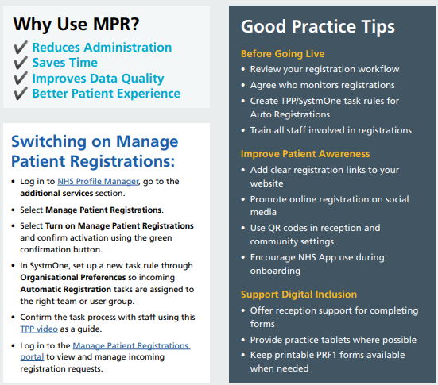
Notes:
To summarise, if you already have Auto Reg switched on in practice, you will just need to turn on Manage Patient Registrations in NHS Profile Manager and use the link to the portal to access the registrations coming through.
If you haven’t got anything at the moment, you will need to turn on Manage Patient Registrations in NHS Profile Manager, set up the tasks in the configuration of SystmOne and then use the link to the portal to access the registrations coming in.

Slide 37
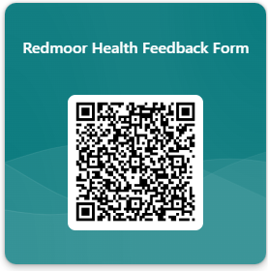
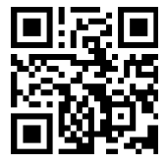

Feedback
£25
Notes:
Just before we move on to any questions, we would be grateful if you could fill out our feedback form for today’s session.
This helps us to make sure we are sharing the right information, making it valuable for practices to attend.
If you fill it in, you will go in the draw to win a £25 Amazon voucher!
https://wkf.ms/3EgVmdM

Slide 38
Any Questions?

Slide 39
Thank you!

